Slide 1

Implementation of Sustainability Criteria for
Biofuels and Bioliquids in Portugal
Cristina Matos; Francisco Gírio
Researcher at Bioenergy Unit
Cristina Oliveira, Luís Silva, Rafał Bogel-Łukasik

Slide 2

Outline
Portuguese National Laboratory for Energy and Geology
Unit of Bioenergy (UB)
UB work on Biofuel Sustainability
Renewable energy in Portugal
Renewable energy in the Portuguese transport sector
Promotion of Biofuels in Portugal
Implementation of the sustainability criteria
Conclusions
http://mente-gritante.blogspot.com/

Slide 3

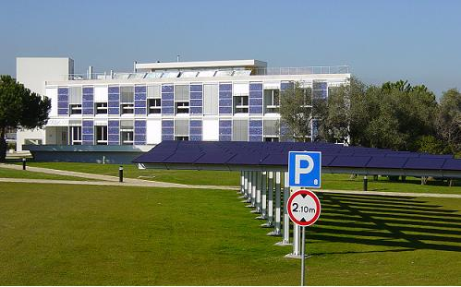
National Laboratory for Energy and Geology
Energy Laboratory

Slide 4
Research for Sustanability
R&D
Public
Policy Support
LNEG
R&D mission:
LNEG works on research, demonstration and technological development to promote technological innovation by directing science and technology for development of the economy, contributing to the increased competitiveness of economic progress under a Portuguese sustainable economy.
Public policy support:
LNEG, an institution of the Ministry of Economy, Innovation and Development, works as a consultant for public policy on energy and geology, environment, sustainability, metrology, standardization, quality and certification.

Slide 5
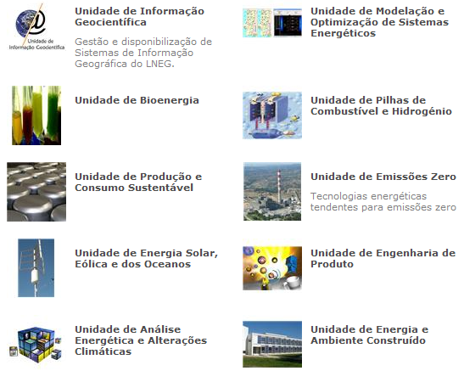
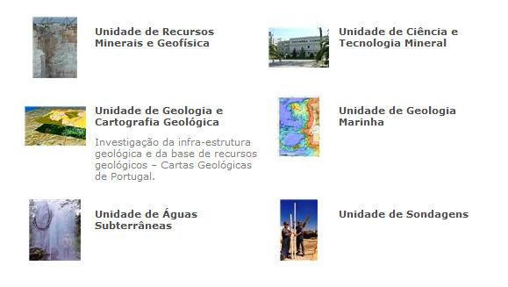
16 R&D Units

Slide 6
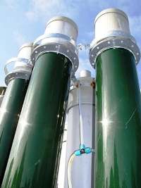
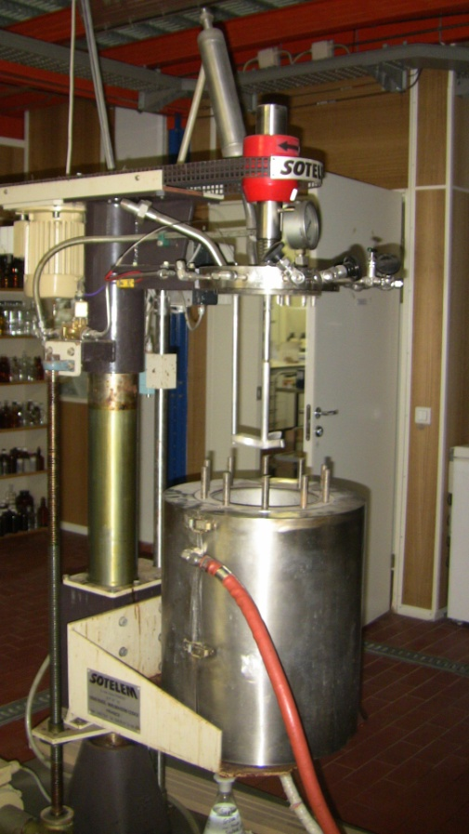
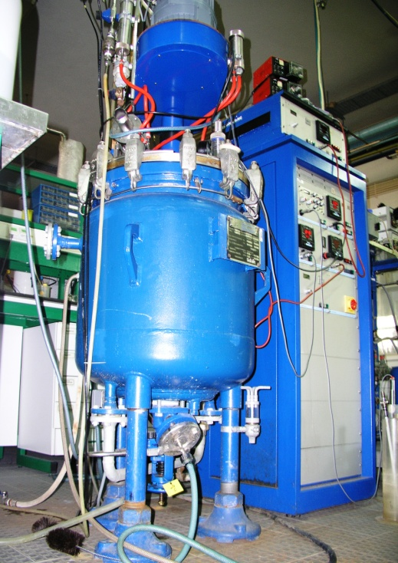
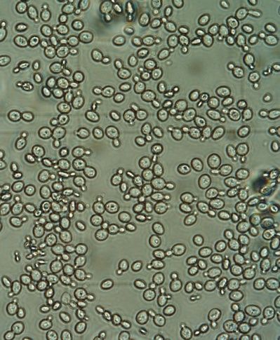
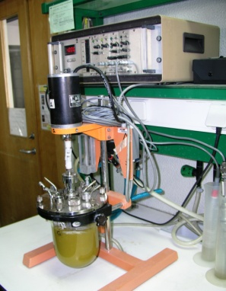
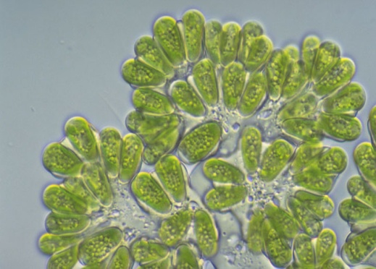
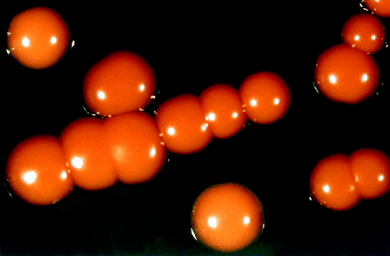
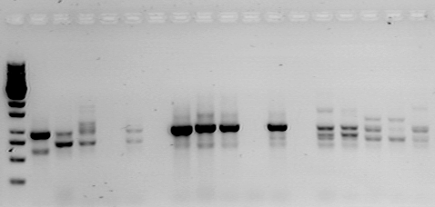
UNIT OF BIOENERGY R&D programs
Biotechnology of microalgae
Pretreatments
Microbiology, Microbial Physiology
And Molecular Biology
Fermentation
Lab of Fermentation Technology
Pilot unit for microalgae growth
Lab of Biomass Deconstruction
30 R&D projects funded during last 5-years
Lab of Cell Factories & Enzymes
Head: F. GÍRIO

Slide 7
Bioenergetic Technologies at UB
Biofuel type | Specific name | Raw material | Technology | Technological maturity
Synthetic biofuels | Biomass-to-liquids (BTL): diesel FT; bioMeOH; Bio-DME | Lignocellulosic materials, microalgae | Gasification & syntesis | R&D (5-20 years)
Bioethanol | Cellulosic bioethanol | Lignocellulosic materials, microalgae | Advanced hydrolysis & fermentation | R&D (3-20 years)
Biodiesel (FAME) | Biodiesel | Microalgae, vegetable oils and animal fats | Growth, oil extraction & transterification | R&D (3-20 years)
Biodiesel (HVO) | Biodiesel hybrid between 1st and 2nd generation | Vegetable oils, animal fat, microalgae | Hydrogenation (refining) | Commercialization (1-5 years)
Biogas | SNG (synthetic natural gas) | Lignocellulosic materials, microalgae, Wastes | Gasification & syntesis | R&D (5-20 years)
Biohydrogen | Biohydrogen | Lignocellulosic materials, wastes | Gasification & syntesis or fermentation | R&D (5-20 years)

Slide 8
UB work on Biofuel Sustainability
Assessing the impact of biofuel technologies;
GHG emissions calculations;
Public policy support on the regulation of biofuel sustainability;
Creation of the National Authority for Monitoring the Sustainability Criteria of Biofuels and Bioliquids.
Environmental
Social
Economical
Eco-efficiency
Socio-Environmental
Sustainable
Socio-Economical
Adapted from: http://www.profissionaisti.com.br/2009/01/sustentabilidade-em-ti-indo-alem-da-ti-verde/

Slide 9
UB work on GHG emissions calculations
60 %
GHG Emissions gCO2eq/MJBiofuel
Process Stage | Initial UB studies, JEC Data | Typical GHG valeus RED
Cultivation of Sunflower | 16.7 | 18
Biodiesel Production | 14.9 | 16
Biodiesel Transport | 1.6 | 1
Total | 33.2 | 35
Reproduction of the typical values of annex V of RED, using JEC results;
Life cycle assessment performed for several biofuels’ value chains;
Differences of more than 2%.

Slide 10
UB work on GHG emissions calculations
Biograce Input
60 %
GHG Emissions gCO2eq/MJBiofuel
Process Stage | UB studies, JEC Data | Typical GHG valeus RED
Cultivation of Sunflower | 17.7 ≈ 18 | 18
Biodiesel Production | 15.6 ≈ 16 | 16
Biodiesel Transport | 1.3 ≈ 1 | 1
Total | 34.6 ≈ 35 | 35
Biograce Input
List of standard conversion values, from JEC consortium;
Correction of the global warming potentials used by JEC consortium.

Slide 11
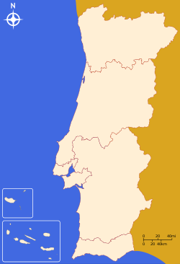
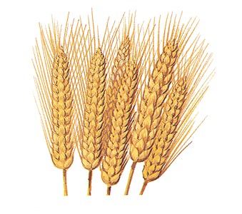
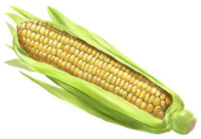
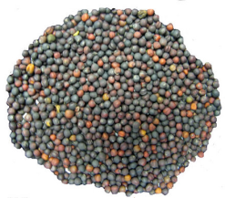

UB work on GHG emissions calculations
Assessment of the GHG emissions from feedstock cultivation in different Portuguese regions;
Sunflower in Centro and Alentejo and Maize in Centro showed lower GHG emissions than RED default values.
18
gCO2eq/MJ
13
gCO2eq/MJ
50
gCO2eq/MJ
33
gCO2eq/MJ
18
gCO2eq/MJ
13
gCO2eq/MJ
14
gCO2eq/MJ
Harmonization is important for the N2O soil emissions.

Slide 12
Renewable Energy in Portugal
and the Renewable Energy Directive 2009/28/EC

Slide 13
RED Renewable Energy Shares
Portuguese Perspective for 2020
Mandatory share of 31% for 2020
Increase of 11.3% of renewable energies comparing with the value of 2005.
This increase will correspond to the following renewable shares for each sector:
30.6 % of RES in heating and cooling
55.2 % of RES in electricity
10 % of RES in transports
31%
Transports
20%
Electricity
Heating and
cooling
Source: PNAER
Source: PNAER

Slide 14
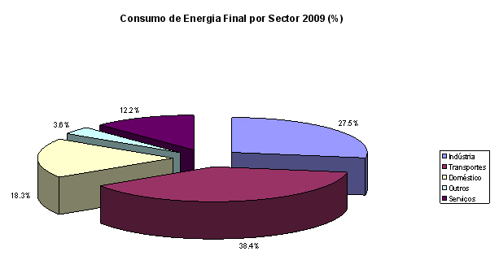
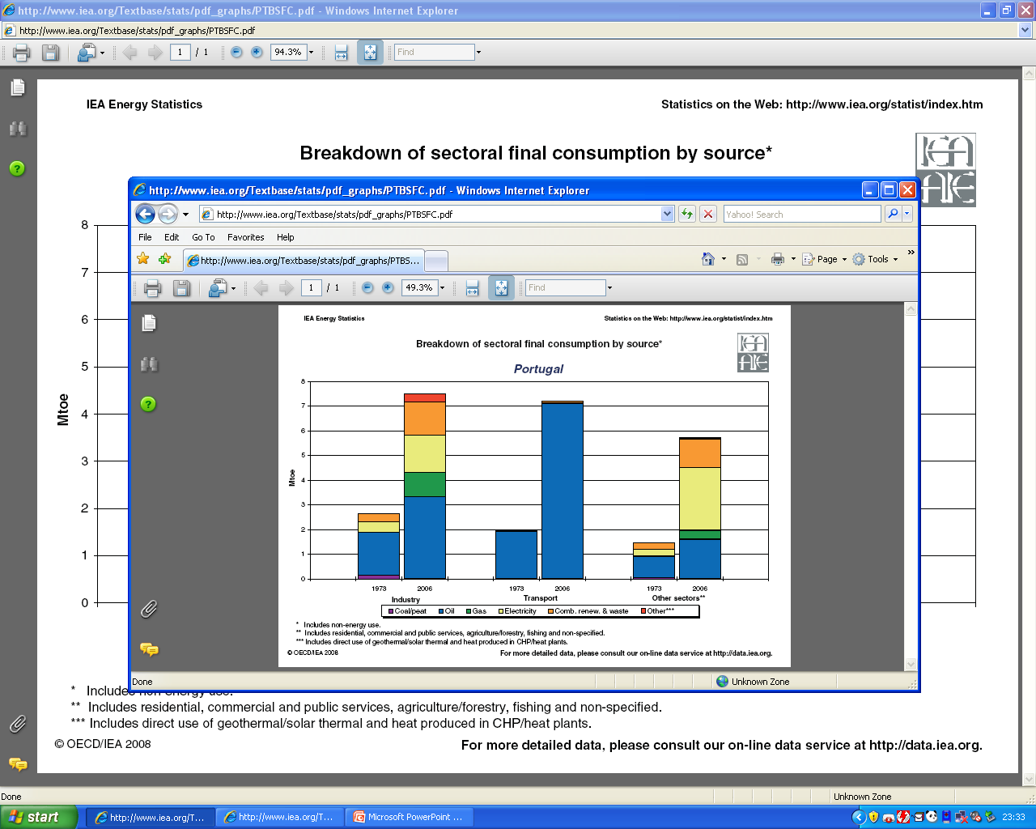
Energy Consumption in the
Transport sector (2009)
Coal
Petroleum
Gas
Electricity
Combustion
Others
Carvão/Turfa
Petróleo
Services
Gás
Serviços
12.2%
Industry
Electricidade
Other
Indústria
27.5%
Comb. renov. e resíduos
Outros
3.6%
Outros***
Household
Mtoe
Doméstico
18.3%
Transports
Transportes
38.4%
Indústria
Transporte
Outros sectores**
Industry
Transports
Other
*Inclui uso não-energético
**Inclui sector residencial, comercial e serviços públicos, agricultura/floresta, pesca e outros não especificados
***Inclui o uso directo de geotérmica/solar térmica e calor produzido por unidades CHP
Source: A factura energética portuguesa 2009, DGEG
The transport sector is still extremely dependent on fossil fuel (∼ 98 % in 2006)

Slide 15
Renewable Energy in the
Portuguese Transport Sector
2009-2010 – current status
Biofuels (only biodiesel)
2020 - prospectives
Electricity for battery-powered cars
- Biofuels (biodiesel and bioethanol)

Slide 16
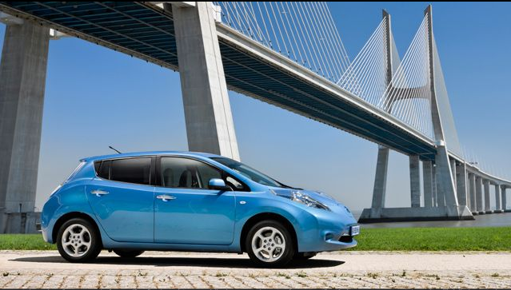
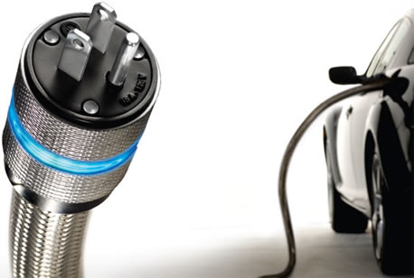

Electricity for battery-powered cars in Portugal
Portugal will manufacture the innovative laminated Li-ion Batteries for Nissan electric vehicles.
A refuelling network for electric vehicles (Mobi-E) will be installed in the country:
  100 public charging stations (2009)
  1300 public charging stations (2011)
http://www.nissan.pt/PT/pt/vehicles/electricvehicles/leaf.html#vehicles
Nissan Leaf (autonomy: 160 km); available from the end of 2010 in Japan, Europe and USA.
http://www.gestao-frotas.com/tag/mobi-e/
Mobi-E refuelling network for electric plug-in vehicles (Portuguese patent)

Slide 17
Promotion of Biofuels in Portugal
Tax exemption for biofuels when blended in diesel or petrol.
Setting incorporation shares of biofuels 2% for 2005 and 5.75% for 2010 (energetic value).
Creation of incentives for the incorporation of biofuels from residues and endogenous feedstocks.
DL 66/2006, 206/2008; Portarias 1391-A/2006, 3-A/2007, 1554-A/2007, 13/2009, 134/2009.
From 2006 to 2009
From 2009 to 2010
Setting minimal mandatory shares for the incorporation of biofuels in diesel:
  6% (v/v) for 2009;
  10 % (v/v) for 2010.
Directive 2009/28/EC the goal of 10% share of renewables in the transport sector will be accomplished with ≈90% of biofuels and ≈10% of electricity. Source: PNAER

Slide 18
Promotion of Biofuels in Portugal
25th October 2010 transposition of RED articles 17-19 and annexes III and V:
Sets the minimal mandatory shares for biofuels in the transport sector.
DL nº 117/2010
 |  | 2011-2012 | 2013-2014 | 2015-2016 | 2017-2018 | 2019-2020
% of biofuels incorporation in fossil fuels (energetic value) |  | 5 | 5.5 | 7.5 | 9 | 10
% of bioethanol incorporation in fossil fuels (energetic value) |  | 0 | 0 | 2.5 | 2.5 | 2.5
Biofuels | Bioethanol (kton)* | 0 | 0 | 58 | 58 | 58
 | Biodiesel (kton)* | 365 | 402 | 506 | 615 | 688
* Calculations based on diesel and petrol sales from 2009

Slide 19
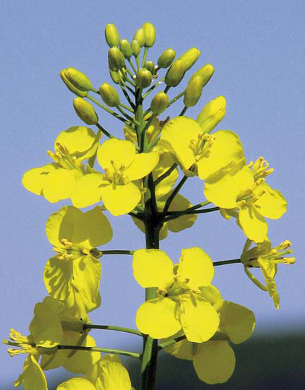
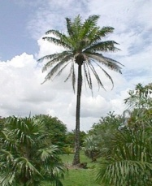
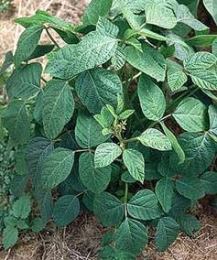
Biodiesel in Portugal (2011)
Principal producers and industrial capacity
Rapeseed
Company | Capacity (ton/year) | Production Start-Up (year)
Iberol | 120 000 | 2006
Torrejana | 109 500 | 2005
Prio-Biocombustíveis | 100 000 | 2007
Biovegetal (SGCEnergia) | 120 000 | 2007
Sovena | 95 000 | 2008
Valouro | 50 000 | 2011
Bioportdiesel | 31 536 | 2011
Total | 626 036 | -
Palm
Soya
Source: DGEG
Raw Materials used in the production of 1st generation biodiesel

Slide 20
Promotion of Biofuels in Portugal
25th October 2010 transposition of RED articles 17-19 and annexes III and V:
Sets the minimal mandatory shares for biofuels in the transport sector.
Sets the biofuel sustainability criteria for GHG emissions and land use.
1) GHG emission reduction:
35 % until 31.12.2016;
50 % from 01.01.2017;
60 % from 01.01.2018
2) Land use, biofuels shall not be made from raw material
obtained from :
land with high biodiversity value
(e.g. primary forest, protective lands, grasslands – to
be defined by national law after EC decision);
land with high carbon stock
(e.g. wetlands, continuously forested areas) and
peatlands.
DL nº 117/2010
Environmental
Social
Economical
Eco-efficiency
Socio-Environmental
Sustainable
Socio-Economical
Adapted from: http://www.profissionaisti.com.br/2009/01/sustentabilidade-em-ti-indo-alem-da-ti-verde/

Slide 21
Promotion of Biofuels in Portugal
Sets the minimal mandatory shares for biofuels in the transport sector.
Sets the biofuel sustainability criteria;
Promotes the more sustainable technologies;
Establish a system of biofuel titles to control the biofuel incorporation goals (TdB).
DL nº 117/2010
25th October 2010 transposition of RED articles 17-19 and annexes III and V:
Environmental
Social
Economical
Eco-efficiency
Socio-Environmental
Sustainable
Socio-Economical
Adapted from: http://www.profissionaisti.com.br/2009/01/sustentabilidade-em-ti-indo-alem-da-ti-verde/

Slide 22
Biofuel Title System
Function
Verification of the incorporation goals.
Emission
After verification of sustainability criteria compliance.
Valeu
One TdB represents one Toe of biofuel.
Promotion for the use of wastes, residues, non-food cellulosic material, lignocellulosic material and endogenous material.
Raw Material | Nº of TdBs per Blended Toe
Wastes Non-food cellulosic material Lignocellulosic material Non-food Endogenous material Endogenous material | 2 TdBs 2 TdBs 2 TdBs 1,3 TdBs 1,1 TdBs

Slide 23
Promotion of Biofuels in Portugal
DL nº 117/2010
Sets the minimal mandatory shares for biofuels in the transport sector.
Sets the biofuel sustainability criteria;
Promotes the more sustainable technologies;
Establish a system of biofuel titles to control the biofuel incorporation goals (TdB);
Creates the Authority for Monitoring the Sustainability Criteria of Biofuels and Bioliquids (ECS) in LNEG.
25th October 2010 transposition of RED articles 17-19 and annexes III and V:
Environmental
Social
Economical
Eco-efficiency
Socio-Environmental
Sustainable
Socio-Economical
Adapted from: http://www.profissionaisti.com.br/2009/01/sustentabilidade-em-ti-indo-alem-da-ti-verde/

Slide 24
DGEG
Identification of Biofuel production quantities
ECS
Verification of the sustainability criteria
DGEG
Verification of Biofuel incorporation
Verification of Biofuel Sustainability
Verification of the
Sustainability Criteria
TdBs Emission
Compliance with the:
1. GHG reduction Criteria
2. Land Use Criteria
Emited to:
1. Biofuel producers
2. Biofuel importers

Slide 25
Verification of Biofuel Sustainability
GHG reduction Criteria
Land Use Criteria
Raw materials cultivation
Raw materials transportation
Processing
Biofuel Plant
Transportation, Blending and Distribution
TdB Emission
Proof of compliance of sustainability criteria from the entire value chain, through a mass balance system.
Adaptado de: http://www.profissionaisti.com.br/2009/01/sustentabilidade-em-ti-indo-alem-da-ti-verde/

Slide 26
Conclusions
The renewable energy share in the transport sector will be 10% in 2020.
Gradual mandatory shares of biofuels (both biodiesel and bioethanol) are set until 2020.
The created biofuel title system will be used for:
  The verification of the sustainability criteria;
  The verification of the incorporation shares.
The National Authority for Monitoring the Sustainability Criteria of Biofuels and Bioliquids was created in LNEG (ECS), which will:
  verify the biofuel and bioliquids sustainability criteria for GHG emissions and land use and;
  emit the TdBs.
Future goals:
Decrease the dependence from fossil fuels.
Promote the use of new technologies for the production of more sustainable biofuels, with high reduction of GHG emissions.
Development of biofuels produced from wastes, residues, non-food cellulosic material, lignocellulosic material and endogenous material.

