Slide 1
Barriers (and Solutions...)
to Very High Wind Penetration
in Power Systems:
The Iberian Case Study.
Ana Estanqueiro (1) and J. Peças Lopes (2)
(1) INETI - Instituto Nacional de Engenharia, Tecnologia e Inovação, I.P.
MINISTRY OF ECONOMY AND INNOVATION
(2) INESC-Porto, Faculdade De Engenharia da Universidade Do Porto
EWEC 2009, 18th of March, 2009, Marseille, France

Slide 2
State of the art...
Several countries and regions in Europe already have high to very high wind penetration.
Wind generation is highly variable in time and space and it doesn’t offer guarantee of power. High penetration requires added reserves (and costs…) for some power systems;
The concept of renewable energies technical maximum penetration limit is unacceptable: the issue is economical
Transmission grids and operation strategies to cope with wind generation from a high to a very high level are being developed: there are solutions already identified and/or in use for the most common grid/system constraints.
slide 2 of 19

Slide 3
Common Technical Barriers to High Wind Penetration
Limited Capacity of the Grid
Wind doesn’t offer Security of Supply and impacts on Power Unit Scheduling
C. If a system already has a significant amount of RES, wind integration in large amounts may produce Energy Congestion / Surplus Management
slide 3 of 19

Slide 4
Technical Power Barriers to High Wind Penetration
A) Transmission Grid Limited Capacity
Most classical “technical” barrier
- Although is really an economic one, not a technical…
- In Europe this issue is being addressed in different ways. Both Iberian countries nowadays include RES and particularly wind energy in their transmission grid development plans.
- For the distribution grid reinforcement costs, different countries have different solutions: from 100% utility support up to 100% payment by the wind developer. In Iberia costs are shared.
2) Common to all new power plants, RES or not.
slide 4 of 19

Slide 5
Technical Power Barriers to High Wind Penetration
B. Security of Supply. Unit Scheduling
1) Balancing Power
Wind is (totally) time dependent and gives no guarantee of firm power… there are added costs for wind integration for some power systems.
2) The excessive “Wind Power Variability”
wind forecasts are improving every day, being used by all major TSOs in Europe with acceptable deviations within time ranges useful for power system operation. The Iberian scale and reduced correlation on the peninsula scale will have an highly positive impact.
3) Wind Generation Technical Reliability
The main concern of every TSO with high penetration is the sudden disconnection of all or most of the wind generation as a response to a fast grid perturbation, normally referred as a “voltage dip”. Iberian grid codes are very similar, but not equal…
slide 5 of 19

Slide 6

Part 2: Using calls for tenders
as a tool to improve the wind technology performance.
Ana Estanqueiro(1), J.A. Peças Lopes(2)
(1) INETI - Instituto Nacional de Engenharia, Tecnologia e Inovação, I.P.
Director of Wind and Ocean Energy R&D Unit,Chair IEA Wind
(2) FEUP/INESC-Porto
Respond Project Workshop, 7th February 2008, Madrid

Slide 7
The Portuguese Energy Status
(July 2005)
Strong electricity consumption growing
Introduction of market approach in the TSO (REN) technical and commercial management
Vision of a paradigm change
slide 7 de 30

Slide 8
The Portuguese energy mix for 2010 (data July 2005)
Total consumption total: ≅ 60 TWh (yearly growing rate - 4,5%)
Renewable generation (with EU 2001/77/CE Directive): ≅ 23,0 TWh
slide 8 de 30

Slide 9
The problems (or challenges!...) we faced:
The:
strong variability of the wind resource;
and wind power plants less robust operation than desirable by the system’s operators.
Rose concerns in areas as:
security of supply;
system operation and regulation;
robustness of the system operation.
slide 9 de 30

Slide 10
How to overcome these issues?
Development of new concepts and regulation strategies, as well as market and operation approaches
  Wind power generation monitoring ;
  “Over-capacity” installation in wind parks;
  Storage solutions and active DSM
  New products: Balance (call options) and capacity markets
New System Operation Tools
  Introduction of a Grid Code
  Aggregation agents for DGS
  DGS dispatch centres
  Innovative functionalities of dispatch centres (EMS / DMS)
Improved Performance of the Wind Technologies
  Increase of controllability
  RTF capability
slide 10 de 30

Slide 11
New Concepts and Strategies of Operation
The management of the wind power variability requires added investment in energy storage:
  Reversible hydro power stations;
  Other storage techniques (compressed air/gas, H2, flywheels)
  That allow to:
    Minimize deviations to participate in structured markets;
    Contribute to the secondary and tertiary power reserves;
    Increase of wind contribution for the regulation capacity
  Definition of the retribution for the reserves in the Portuguese control area
Upper reservoir
Lower reservoir
Hydro
Wind Park
Pumping
Power plant
slide 11 de 30

Slide 12
New Hierarchic Structures for the Power System Management (DSOs +…)
MIBEL
Wind Production Forecast
slide 12 de 30

Slide 13
Increase of the WT controllability:
RTF capability
WT participation in the
voltage and frequency
control
slide 13 de 30

Slide 14
Portugal:
The roadmap to a ’’green system’’
The necessity to reinforce the renewable component in the mix (highly variable) required:
  An attitude change by the TSO
  Adoption of new operation strategies
  Development of new solutions for the market balance, reserves and capacity.
But also enable to develop regional industrial capability adapted to the local technological specificities.
  Power converters and their control
  Protections
  Aggregation agents e VPS software
  Functionalities for EMS and DMS
slide 14 de 30

Slide 15
In synthesis, the innovative systems required may act as drivers for technological development
•
Investigação
Básica
•
Colaboração
com
as
Universidades
•
Investigação
•
Simulação
e
Experimentação
Aplicada
e
•
Desenvolvimento
de
Infraestruturas
Desenvolvimento
Tecnológico
•
Demonstração
de
•
Demonstração
e
projectos
piloto
Projectos
Piloto
•
Integração
Tecnológica
•
Apoio
a fabricantes
locais
•
Produtos
Comerciais
•
Ensaios
,
Certificação
•
Serviços
ao
mercado
•
Mercado
/
Serviços
•
Exploração
de
resultados
da I&D
•
Spin
-
offs
•
Apoio
às
empresas
do cluster
industrial
slide 15 de 30

Slide 16
Legal Context for the Call
The call is opened in the terms of art. 14º of DL n.º 312/2001, 10th of December, and subsequent legislation, as art. 8º of DL nº 33-A/2005 of 16th of February.
slide 16 de 30

Slide 17
Objectives of the Call for Tenders
Within that call it is attributed grid capacity (SEP) for power injection generated by wind power stations e the correspondent reception points (PCC), up to the limit of 1500 MVA.
The call has 2 sequential phases:
Phase A: concession of capacity up to 800 MVA;
Phase B: concession of capacity up to 400 MVA.
slide 17 de 30

Slide 18
General Aspects of the Call
Although not compulsary, it was intended that the propostas should include a regional project for wind technology industrial development, that could be different for for Phase A and Phase B.
Participants could present Proposals to Phase A and Phase B of the call or only one of them.
Each competitor cannot wind more than of “batch” of capacity, i.e. winning Phase A means withdrawing from Phase B.
slide 18 de 30
slide 18 de 26

Slide 19
Participants minimum requirement
Minimum requirements for the call
participants:
  Economical and financial capacity:
    (…)
  Technical capacity:
    Experience in the development and management of wind power plants, with the minimum installed capacity of 30 MVA;
slide 19 de 30

Slide 20
The proposals
  Conditional proposals or variations not admissible.
  Proposals presented to Phase A should identify the Grid Areas and PCCs (transmission substations) to which the wind parks are going to connect.
  Proposals to Phase B cannot request Grid Areas or PCCs, but on an indicative manner. Phase B is technically dependent from the outcome of Phase A.
slide 20 de 30

Slide 21
Technical Minimum
Requirements of the Proposals
Cumulative Technical Minimum Requirements were asked:
  “Ride Through Fault” capability
    i.e. survival to voltage gaps, eventually produced in the transmission network with origin in short-circuits or other transient events.
  Delivery of reactive power during transient occurrences in the grid SEP (voltage dips)
  Capacity of the wind technology to adjust, by request of the system operator, the injected reactive power within values of tg ϕ in the interval [0, + 0,2]
slide 21 de 30

Slide 22
Technical Minimum
Requirements (1)
  Ride Through Fault * Capability
  *a constar do código da rede em elaboração
*to include in the grid code under elaboration
slide 22 de 30

Slide 23
Technical Minimum
Requirements (2)
2. Delivery of reactive power during transient* occurrences in the grid SEP (voltage dips)
  *to include in the grid code under elaboration
(2)
*to include in the grid code under elaboration
slide 23 de 30

Slide 24
Rewards for
Proposals with Exceptional Merit
The grid capacity values to concess may be increased by up to 20% of “overpower”, of the capacity value attributed, if the Proposal selected is considered by the Jury to have exceptional merit accorfing the Portugal national energy strategy:
Maximum Added capacity:
Phase A - 200 MVA;
Phase B - 100 MVA.
slide 24 de 30

Slide 25
Criteria of Selection
The proposals are ranked by the obtained ponctuation according to the following criteria
slide 25 de 30

Slide 26
Criteria and sub-criteria
C1.Technical Capacity for the Management of Wind Parks’s Clusters
  The points for this criteria were:
slide 26 de 30

Slide 27
Criteria and sub-criteria
C2. Management of Wind Energy Production
  Offer to accept, during the no-load period and by request of the TSO, a reduction of the existing (available) wind generation.
  The weight of this offer is done linearly for the number of disconnection hours offered above 20 h, acc a function described in the official call text (CE).
slide 27 de 30

Slide 28
Criteria and sub-criteria
C3. Energy Storage Solutions
  Offer of energy management capacity in the integrated (wind production and energy storage) form, expressed in terms of the amount of energy that the participant is capable of “transfer” on a daily basis.
  The offer is weighed by the energy value E, in MWh, that the participant is able to transfer from wind to the storage, normalised by the reference value Eref (MWh) generated by the competitor during 1 hour of operation at nominal power, acc to a function described in the call text (CE).
slide 28 de 30

Slide 29
Criteria and sub-criteria
C4. Aditional reactive Power Control
  Added capacity and flexibility in the reactive power control injected for tg ϕ varying in the interval [-0.2, 0] to be made available by the wind turbines/parks, when required by the TSO.
C5. Participation in the frequency primary regulation
  Offer of the ability of the wind technology to participate with, at least, 5% of “deload”, when required by the system operator, for primary frequency regulation.
  This sub-criteria is valued acc to the percentage of deload offered by the competitor..
slide 29 de 30

Slide 30
Criteria and sub-criteria
D. Support to Innovation in the Wind Energy Domain
  This criteria weights the value of incentives and support to innovation (in the form of a fund) to attribute by the participant in the 4 years after the signature of the concession’s contract, (1 point by each 250 thousand euros, with an upper limit of 100 points.
slide 30 de 30

Slide 31
Weights - Phase A
slide 31 de 30

Slide 32
Weights - Phase B
slide 32 de 30

Slide 33
Final scoring of the proposals
Phase A
  P = 0,20 A1 +(0,11 B1 + 0,08 B2 + 0,11 B3 + 0,08 B4 + 0,07 B5) x B6 + 0,1 C1 + 0,025 C2 + 0,075 C3 + 0,025 C4 + 0,025 C5 + 0,1 D1
Phase B
  P = 0,175 A1 +(0,125 B1 + 0,075 B2 + 0,125 B3 + 0,075 B4 + 0,075 B5) x B6 + 0,1 C1 + 0,025 C2 + 0,075 C3 + 0,025 C4 + 0,025 C5 + 0,1 D1
slide 33 de 30

Slide 34
Technical outcome of the call
Phase A
  1200 MVA contracted, proposal addressed all technical requirement (minimum and volunteer offers)
    Two DSO to be installed (one under installation)
    1062 MVA added wind generation management,
    50 hours of 5% deload, maximum energy storage in hydro reversible systems, 35 Million Euros in a fund for innovation
Phase B
  400 MVA contracted, proposal addressed all technical requirement (minimum and volunteer offers)
    One DSO to be installed
    465 MVA added wind generation management,
    50 hours of 5% deload, maximum storage in hydro reversible systems, 35 Mill Euros in a fund for innovation
slide 34 de 30

Slide 35
Other outcomes of the call
Several new industrial wind units
A wind technology industrial cluster exists now in Portugal,
but it took us two years!....
[...from July 2005 to August 2007].
slide 35 de 30

Slide 36
Technical Power Barriers to High Wind Penetration
C. Operational Energy Congestion. Surplus Management
Different generation mixes face different challenges:
In power systems where the energy mix is flexible in its regulation, there is almost no added reserve cost associated with the integration of wind in the system
  - e.g. high penetration of hydro plants with storage capacity. In Portugal the high hydro penetration easies things – In Spain it doesn’t. To enlarge the control area (MIBEL) will help to overcome this (for Spain at least…).
However…
2) an issue that is commonly raised in these systems is the possibility of of surplus of renewable generation (e.g. wind + hydro) that raises the uncomfortable issue of either disconnecting wind generators or spilling water
  - which would be turbinable in the absence of wind. The issue is (again) more economical than technical. MIBEL will greatly benefit both countries due to the essentially different energy mix and load profiles.
slide 36 of 19

Slide 37
Tools and Methods to find
Solutions
slide 37 of 19

Slide 38
Solutions: The Future Power Systems with Large Wind Penetration
Smart dealing with Grid Capacity
GIS location of the wind resource (“as geographical wind dams”) and grid connection demands from the wind farm developers, enable the DSO and TSO to define, if necessary:
When and where to extend the transmission network to avoid large investments for low wind sites or small wind farms.
Grid planning should take into consideration the special characteristics of wind generation, i.e., its time and space variability and consider grid reinforcement vs grid monitoring and wind power control. Curtailment may prove to have high economic benefits and should be assessed.
Combined probabilistic and deterministic approaches are the most appropriate, with the wind modeled, if possible, with spatial correlation factors resulting from the wind resource GIS mapping.
slide 38 of 19

Slide 39
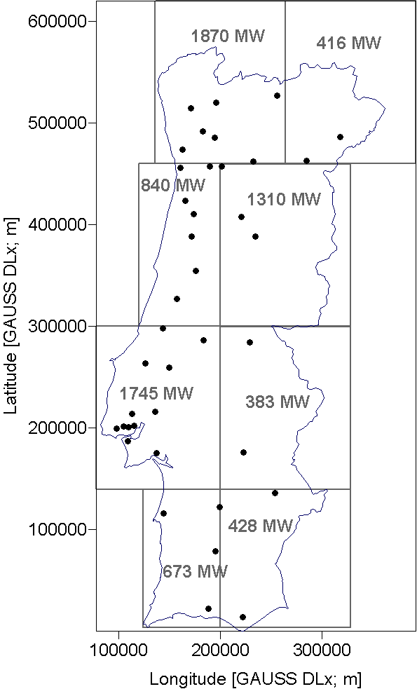
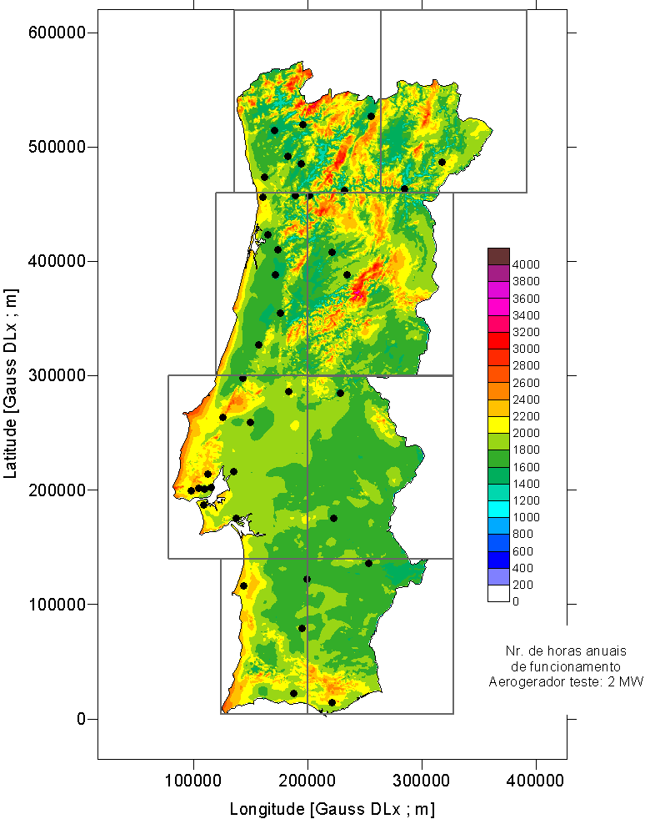
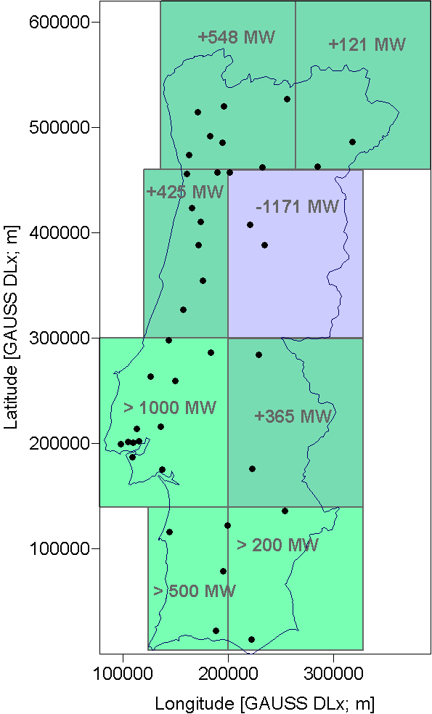
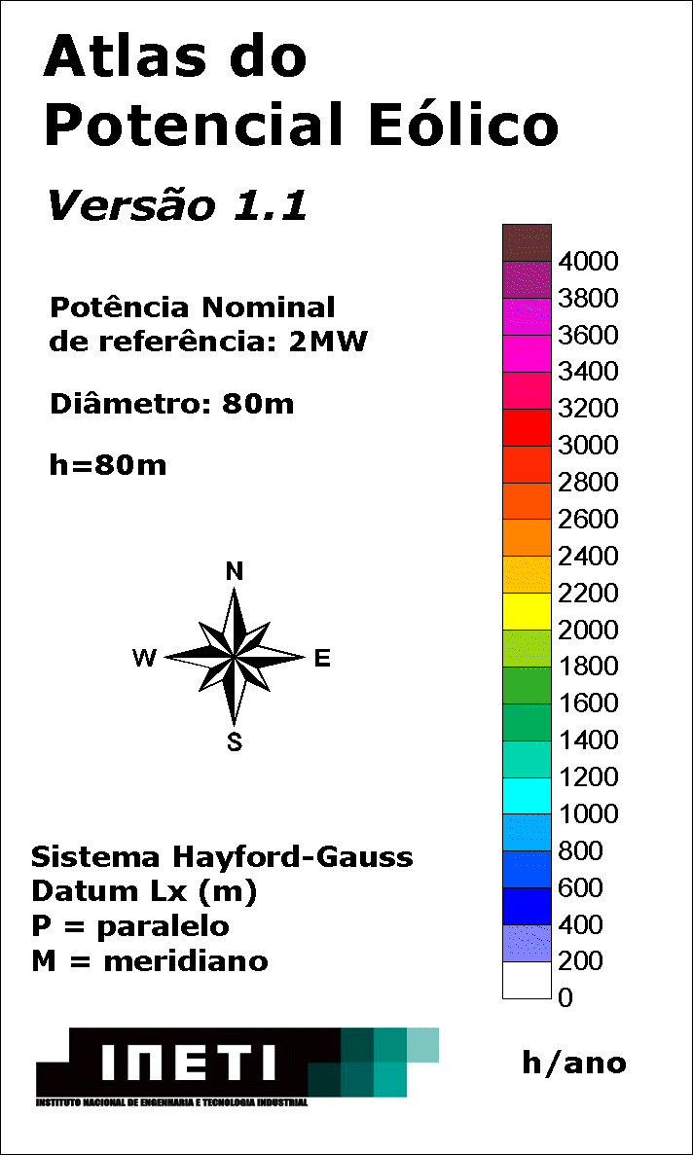
Solutions: The Future Power Systems with Large Wind Penetration
a) Grid capacity
in 2013 (~7000 MW)
(b) Onshore sustainable wind resource
5900 MW (aprox.) + >1000 MW offshore
(c) Deficit/superavit
by region
Local distribution of wind resource vs. TN capacity
slide 39 of 19

Slide 40
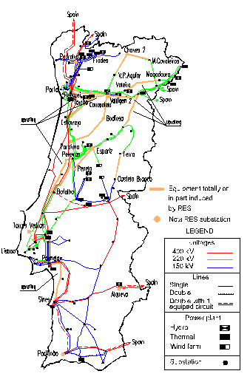
Solutions: The Future Power Systems with Large Wind Penetration
Find RES and load synergies and characterize the existing externalities,
The grid development plan to assess the wind power integration should also characterize the correlation with other RES (mainly hydro) to incorporate externalities and enable to accommodate the maximum RES penetration
Source: REN
Orange lines: RES induced (wind and large hydro)
slide 40 of 19

Slide 41
Solutions: The Future Power Systems with Large Wind Penetration
Integrated Smart Design and Operation of Power Systems
The IEA Wind IA started a new international cooperation project (Task 25) entitled “Design and Operation of Power Systems with Large Amounts of Wind Power”, in the beginning of 2006. In this study, wind impacts on the system were mainly related to their time/range of scale and are globally identified as follows.
1) Regulation and load following [1 to 30 min.]
How the uncertainty introduced by wind power affects the allocation and use of reserves in the system.
2) Efficiency and unit commitment [hours to days]
Impact of wind power time variability and forecasting errors on unit commitment.
3) Adequacy of power [several years]
Avoided investment in conventional units due to existing wind capacity. Total secure supply available during peak load situations.
4) Transmission adequacy and efficiency [hours to years]
Depends on the location of wind farms relative to the load consumption, on the correlation between wind production and load and wind smoothing effect.
[IEA Task 25 – Large Wind Penetration (www.ieawind.org)]
slide 41 of 19

Slide 42
Solutions: The Future Power Systems with Large Wind Penetration
Storage of Renewable Energy
  The concept of wind energy storage - and other highly variable time-dependent renewable primary sources - is already in use in Portugal.
  When hydro pumping storage is available, the methodologies able to identify the best combined wind/hydro pumping storage strategies should be used.
  Wind generation and energy price forecasts that enable to optimise the daily operation strategy can be determined.
  [IEA Task 24 – Wind/Hydro (www.ieawind.org)].
slide 42 of 19

Slide 43
Solutions: The Future Power Systems with Large Wind Penetration
The Inevitable Challenge Towards Change
European TSOs still do not share fundamental information for the operation of their power systems
  and have not implemented the available warning tools to help each other during events as the one that took place on the 4th November 2006.
Taking into consideration the increasing difficulties felt by most, if not all, TSOs to have environmental approval for the construction of new transmission lines it becomes “mandatory” to improve the existing network efficiency and utilization;
  by using online monitoring (temperature, wind, loads, etc), by introducing new components as FACTS, or by upgrading degraded components as cables, protections and transformers - all are urgent measures for TSOs.
slide 43 of 19

Slide 44
Solutions: Innovative Concepts of the
Wind Power Plants already in use
Innovative Characteristics of the Wind Power Plants
  Management of wind parks by clusters (“local wind power dispatch centers”) – already in use in Spain and under construction in Portugal;
  Additional reactive power control: tg fi variable within [-0.2, +0.2];
  Curtailment of wind production for forecasted no-load periods;
  Solutions for “Wind/RES energy storage”: specially as hydropower;
  Participation in the primary frequency control (e.g. 5% of P);
  LVRTF - Ride through fault capability
slide 44 of 19

Slide 45
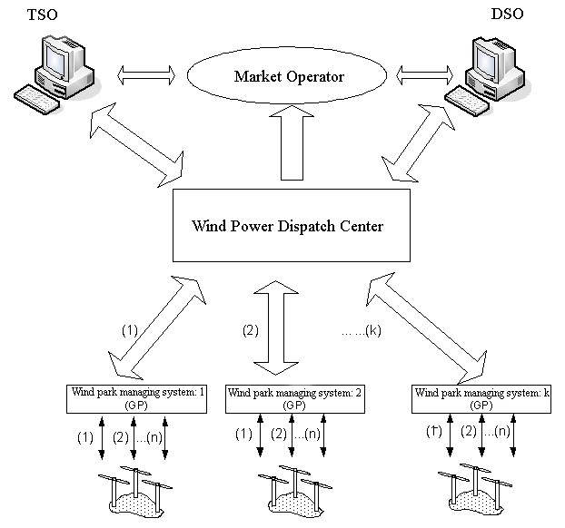
Solutions: Innovative Concepts of the
Wind Power Plants already in use
New strategies and equipments
Installation of Wind Generation Dispatch Centres, acting as
“Generation Aggregation Agents”
the forecasted wind power dispatch centres will enable to monitor and adapt the wind production injection to the system operating conditions without compromising security operational levels.
Source: INESC-Porto
slide 45 of 19

Slide 46
Solutions: Innovative Concepts of the
Wind Power Plants already in use
LVRTF capability + added reactive
Reactive power contribution
required
LV Ride Through Fault Capability
from several Grid Codes
Ireactive / Ipre-fault [%]
U / U_{nominal} [pu]
Source: DGEG
slide 46 of 19

Slide 47
Solutions: Innovative Concepts of the
Wind Power Plants already in use
Wind Power Control and Curtailment
The replacement of conventional generation by hundreds of wind generation units spread over the transmission and distribution system requires the development of new concepts for monitoring, controlling and managing these generation resources.
huge cost
and little
value!...
slide 47 of 19

Slide 48
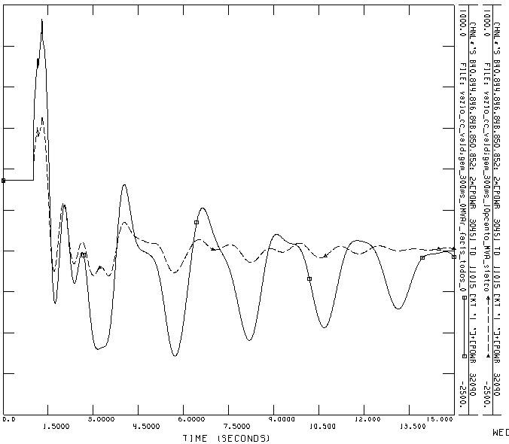
Innovative Concepts of the
Wind Power Plants (already in use)
New strategies and equipments
FACTS
It is also possible to install FACTS in strategic buses of the network:
i) to mitigate the impact of short circuits;
ii) help to prevent the disconnection of large amounts of wind power for under voltage protection relays actuation (much cheaper than equip all WT’s with LVRTF) ;
iii) strongly contributes to the damping of the oscillations.
Source: INESC-Porto
slide 48 of 19

Slide 49
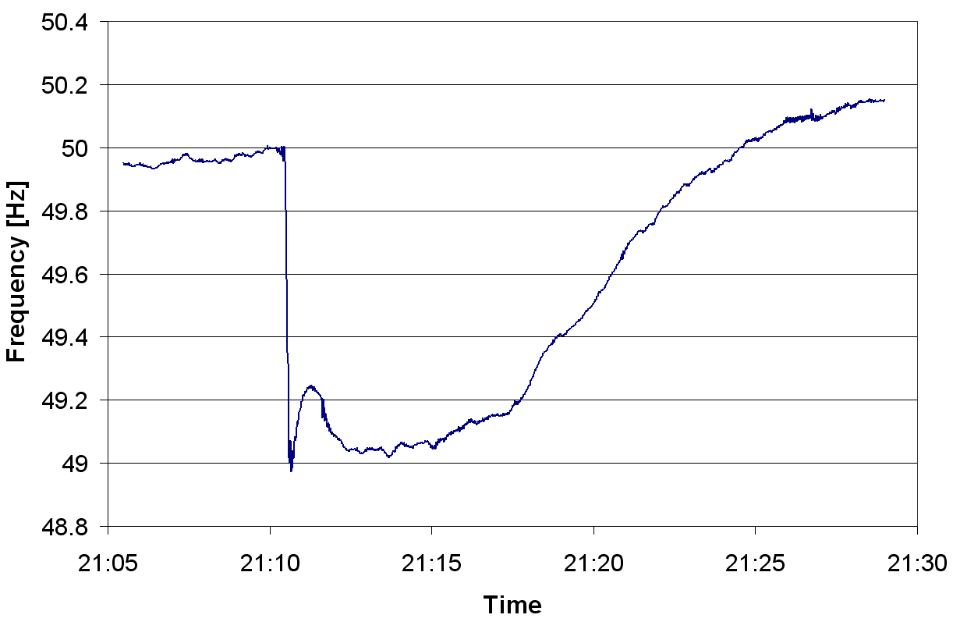
Solutions: Innovative Concepts of the
Wind Power Plants (already in use)
Innovative Characteristics of the Wind Systems
Participation in the primary frequency control (experimentally in Portugal, starting 2008) by (DNO controlled) power curve regulation (frequency dip, 4th Nov.);
Source: REN
slide 49 of 19

Slide 50
Synthesis (1/2)
The wind industry has experienced a remarkable increase in performance in what concerns the power system interface.
The technical studies to assess the impact of high wind penetration are still being accomplished in many countries, however it is already clear that the wind industry has moved in the right direction with the integration of functionalities as LVRTF, remote condition monitoring and added generation control.
final slide 1/2

Slide 51
Synthesis (2/2)
The close cooperation of TSOs, DNO’s and the wind industry clearly indicates it is possible to have wind penetration at large scale, this based on the results of some pioneering countries.
The common barriers that prevented the large wind penetration are nowadays turning into questions as,
  “what part of the wind capacity needs to have LVRTF capability ?”; and
  “when, where and under what circumstances do the wind power stations need to be deloaded ?” in order to provide primary frequency control”.
final slide 2/2

