Slide 1
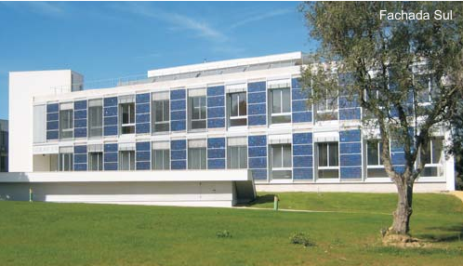

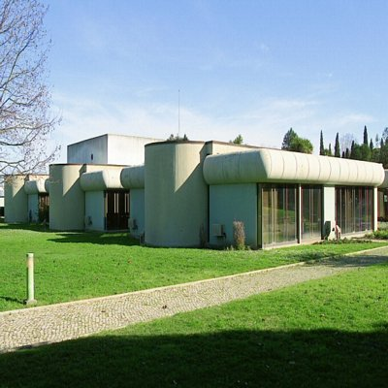
Alegados de Salud de alimentos probióticos en la Unión Europea: Fundamentos científicos y propriedade industrial
Maria do Céu Costa- NobelProbio
Lisboa, 22 September 2009

Slide 2

ALEGACIONES NUTRICIONALES
En la actualidad la legislación prohibe publicar alegaciones nutricionales en el etiquetado de productos dietéticos y alimentos funcionales en marcas que no los tienen o no lo han demostrado científicamente sus beneficios saludables.

Slide 3
EFSA
EFSA: European Food Safety Agency
Alegaciones nutricionales
Con el fin de actualizar la legislación a la realidad de los mercados actuales, la EFSA está evaluando todos los ingredientes presentados para dictaminar la aceptación de sus alegaciones nutricionales. Una vez dictaminadas, la Comisión Europea adoptará la lista definitiva de declaraciones permitidas el próximo 31 de Enero de 2010.

Slide 4
EFSA
EFSA: European Food Safety Agency
Probioticos
Mientras no llega dicha fecha, la EFSA ha empezado emitir resultados sobre algunos de los ingredientes presentados y, como resultado, ya ha rechazado algunas marcas registradas como en lo caso de “Lactoral”, una mezcla de probióticos para mejoras intestinales.

Slide 5
EFSA
EFSA: European Food Safety Agency
Alimentos Funcionales
Por otro lado ya han aprobado las alegaciones nutricionales presentadas para productos como en la vitamina K2 (metabolismo del calcio), xilitol (reducción de la caries), esteres de estanoles (reducción del colesterol), vitamina D y el treonato cálcico (desarrollo óseo en niños).

Slide 6
Alimentos Funcionales y Probióticos
Alegaciones de Salud: Articulo 14 de la Regulation (EC) No 1924/2006[1] - Opinion Scientifica del Painel de Produtos Dieteticis, Nutricion y Alergias
Esta nueva regulación cambiará totalmente el panorama actual de los alimentos funcionales y probióticos, ya que los ingredientes nutricionales aprobados por la EFSA podrán alegar sus beneficios y serán mucho más competitivos que los que no sean aprobados, que seguramente acabaran desapareciendo del mercado.

Slide 7
EFSA OPINION
LACTORAL
Scientific substantiation of a health claim related to LACTORAL
LACTORAL and living probiotic bacteria - a combination of three probiotic strains: Lactobacillus plantarum, Lactobacillus rhamnosus, Bifidobacterium longum and living probiotic bacteria
Question number : EFSA-Q-2008-480
Adopted: 28 October 2008 (by written procedure)
The scope of the application was proposed to fall under a
health claim referring to children’s development and health.

Slide 8
EFSA OPINION
LACTORAL
A freeze-dried bacterial powder for oral administration
Lactobacillus plantarum (PL02) (34%)
Lactobacillus rhamnosus KL53A (33%)
Bifidobacterium longum PL03 (33%)
The total number of bacteria in a dose contained in a sachet (the weight of the sachet was not provided) is claimed by the applicant to be 1010 (10 billions) colony forming units (CFUs)
The bacterial strains have been identified using phenotypic tests, sequencing of 16S-23S rRNA intergene spacer regions (ITS), and species-specific PCR
Problems detected by EFSA Panel
The identification of the bacteria remains doubtful
The Panel considers that these tests are not sufficient for a proper identification of the bacterial strains, e.g. no data were provided to show that the applied identification methods were able to differentiate between closely related species

Slide 9
EFSA CONCLUSIONS
The Panel considers that the quality (regarding viability) of the bacterial powder cannot be evaluated as the results of the storage stability studies for LACTORAL have not been provided.
The Panel considers that the constituents of the food supplement for which the health claim is made, LACTORAL, have not been sufficiently characterised.
Based on the data presented, the Panel concludes that a cause and effect relationship has not been established between the consumption of LACTORAL and the claimed effect.

Slide 10
EFSA
LACTORAL
Assessment
2. 2.1. Characterisation of the food/constituent
LACTORAL, a freeze-dried bacterial powder (in milk-saccharose-maltodextrin matrix) is stated to contain Lactobacillus plantarum (strain PL02) (34% of the mixture), Lactobacillus rhamnosus KL53A (33 %), Bifidobacterium longum PL03 (33%), and possibly also aroma (strawberry or nectarine). The total number of bacteria in a dose contained in a sachet (the weight of the sachet was not provided) is claimed to be 1010 (10 billions) colony forming units (CFUs). The applicant states that to obtain the claimed effect 1-2 sachets should be consumed per day. The claimed health effect has not been attributed to any specific bacterial strain in the product and no relevant data on the potential mechanism of action in vivo for the specific strains have been provided. The bacterial strains in LACTORAL have been identified using the following tests: phenotypic tests, sequencing of 16S-23S rRNA intergene spacer regions (ITS),
and species-specific PCR (Pałuch, unpublished; Heczko and Strus, unpublished).

Slide 11
EFSA
LACTORAL
Assessment
2. 2.1. Characterisation of the food/constituent
The Panel considers that phenotypic tests alone are not sufficient for a proper identification. The DNAbased identification was not considered sufficient for the following reasons: ITS sequencing is currently not reliable enough because too few Bifidobacterium and Lactobacillus strains have been sequenced for this region. Thus the reference material available in GenBank for especially Lactobacillus plantarum and Bifidobacterium longum is too limited for a reliable identification. Furthermore, no analysis of the sequencing results has been provided, only the sequences themselves. Species-specific PCR is reported only in a vague way in a nonpublished report. Based on the material presented the Panel could not conclude about the specificity of the PCR-method (no controls, i.e. other Lactobacillus or Bifidobacterium species, were included). Thus the identification of the bacteria, especially regarding Bifidobacterium longum, remains doubtful. No data have been provided to show that the identification methods are able to differentiate between closely related species (e.g. within Lactobacillus plantarum and Lactobacillus casei groups).

Slide 12
LACTORAL
Scientific Opinion of the Panel on Dietetic Products, Nutrition and Allergies on a request from the Institute of Biotechnology, Sera and Vaccines BIOMED S.A. on the scientific substantiation of a health claim related LACTORAL and living probiotic bacteria. The EFSA Journal (2008) 862, 1- 8.

Slide 13
EFSA OPINION
The additive Probiotic LACTINA®
Safety and efficacy of Probiotic LACTINA®
Scientific Opinion of the Panel on Additives and Products or Substances used in Animal Feed
Safety and efficacy of Probiotic LACTINA® (Lactobacillus acidophilus, Lactobacillus helveticus, Lactobacillus bulgaricus, Lactobacillus lactis, Streptococcus thermophilus, Enterococcus faecium) for chickens for fattening, piglets and pigs
QUESTION EFSA-Q-2006-135
Adopted: 9 December 2008
LACTINA ® is proposed be used as a feed additive for chickens for fattening and piglets (category: zootechnical additives; functional group: gut flora stabilisers).
DATOS
It has not been previously authorised in the Community
Preparation of Lactobacillus acidophilus, L.helveticus, L.bulgaricus, and L.lactis, Streptococcus thermophilus and Enterococcus faecium.
Total lactic acid bacteria is 5 x 10⁹ CFU g-1 product, but … relative amounts of different bacterial strains ?
The product is intended for chickens for fattening
Serious deficiencies in the study design, conduct and reporting of the studies do not allow conclusions on the efficacy of LACTINA® in chickens for fattening
No study on pigs for fattening and therefore no conclusion on the efficacy of the product for this species.
Published: 28 January 2009
Due to the lack of data presented in the dossier and in the supplementary information, the FEEDAP Panel is not able to describe the composition, stability and homogeneity in feed of the product.

Slide 14
EFSA CONCLUSIONS
LACTINA ® Probiotic
In the absence of tolerance studies, the FEEDAP Panel cannot conclude on the safety of Probiotic LACTINA® for the target species.
The lack of data on the antibiotic resistance of the six Probiotic LACTINA® strains and on the presence of known virulence factors in E. faecium NBIMCC 8270 prevents drawing conclusions on the safety of the product for the consumer.
No experimental data on the user safety was provided.
Because of its proteinaceous nature, the possibility for the product to act as a respiratory sensitiser cannot be excluded.
The use of this product as a feed additive would not pose a risk for the environment.

Slide 15
New authorisation of feed additives - Contribution to feed/food safety
Taken from the preamble of the Regulation (EC) 1831/2003
Livestock production occupies a very important place in the agriculture of the Community. Satisfactory results depend to a large extent on the use of safe and good quality of feedingstuffs.
In order to protect human health, animal health and the environment, feed additives should undergo a safety assessment through a Community procedure before being placed on the market
Replacement of antibiotics as growth promoters by alternative products

Slide 16
The new authorisation of feed additives according to Regulation No 1831/2003
The European Food Safety Authority (EFSA) is doing the risk assessment whereas the Commission grants authorisation to the applicants
For each feed additives applicants have to prepare a dossier including methods of analysis for the submitted feed additive to control the conditions of use
The regulation established a Community Reference Laboratory to look at the analytical methods.
The CRL operates for two years.

Slide 17

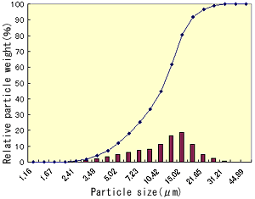
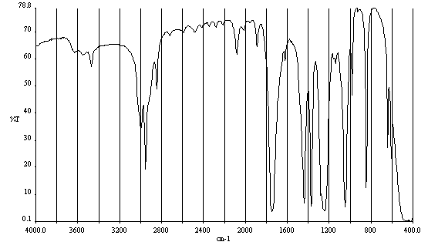
Characterisation of the feed additive
PCR of probiotic yeast strains

Slide 18
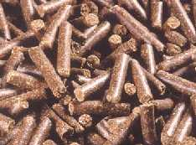
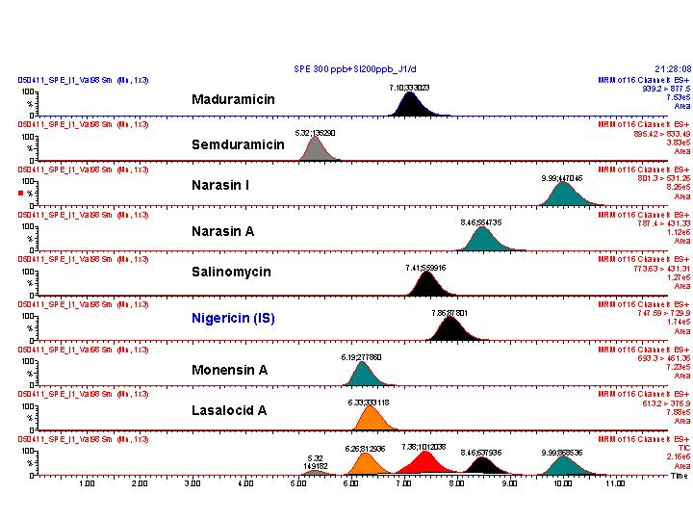
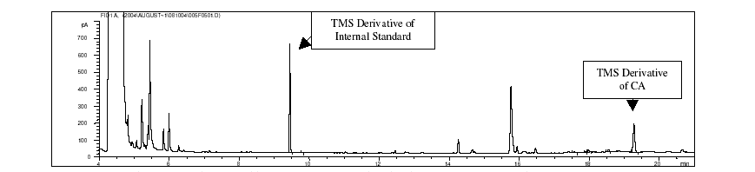
Determination of the active substance in compound feed: A multidisciplinary approach
Coccidiostat analysis by LC/MS
Enumeration of probiotics
Carnosic acid in Rosemary extract

Slide 19
Clinical Studies

Slide 20
Scientific and technical guidance for the preparation and presentation of the application for authorisation of a health claim
Diagram 1: Representation of the organisation of the application*.
© European Food Safety
Authority, 2007 Page 11 of 44

Slide 21
Studies in Nutrition - Points to consider
Health Claims are to be substantiated thus clinical studies are required
No harmonisation yet in Europe or Worldwide in respect to the requirements for conducting the clinical studies when not falling under drug requirements
For EC, usually same process as for drugs but no harmonisation regarding timelines, application forms
For Competent Authority, usually only a notification when applicable
ICF follow GCP requirements
Study, follow ICH-GCP recommendable

Slide 22
Regulations for Studies in Nutrition
Changes are currently observed
France, as of 01 June 2008, CTA submission moved from DGS to AFSSAPS (Article 7 ratifying the ordinance no 2007-613 of 26 April 2007, published in Official Journal on 16 April 2008). Approval is required

Slide 23
Application Forms
Application forms for Nutraceuticals for approval from AFSSAPS
1. form-nsp-1.pdf
2. form-nsp-2.pdf
Notes:
Article 15
Application for authorisation
1. When reference is made to this Article, an application for
authorisation shall be submitted in accordance with the
following paragraphs.
2. The application shall be sent to the national competent
authority of a Member State.
….
3. The application shall include the following:
(a) the name and address of the applicant;
(b) the nutrient or other substance, or the food or the category
of food, in respect of which the health claim is to be made
and its particular characteristics;
(c) a copy of the studies, including, where available, independent,
peer-reviewed studies, which have been carried out
with regard to the health claim and any other material
which is available to demonstrate that the health claim
complies with the criteria provided for in this Regulation;
(d) where appropriate, an indication of the information which
should be regarded as proprietary accompanied by verifiable
justification;
Article 16
Opinion of the Authority
1. In giving its opinion, the Authority shall respect a time
limit of five months from the date of receipt of a valid application.
Whenever the Authority seeks supplementary information
from the applicant as provided for in paragraph 2, such time
limit shall be extended by up to two months following the date
of receipt of the requested information submitted by the applicant.
…
3. In order to prepare its opinion, the Authority shall verify:
(a) that the health claim is substantiated by scientific evidence;
(b) that the wording of the health claim complies with the
criteria laid down in this Regulation.
…
5. The Authority shall forward its opinion to the Commission,
the Member States and the applicant, including a report
describing its assessment of the health claim and stating the
reasons for its opinion and the information on which its
opinion was based.
Article 17
Community authorisation
1. Within two months after receiving the opinion of the
Authority, the Commission shall submit to the Committee
referred to in Article 23(2) a draft decision on the lists of
permitted health claims, taking into account the opinion of the
Authority, any relevant provisions of Community law and other
legitimate factors relevant to the matter under consideration.
Where the draft decision is not in accordance with the opinion
of the Authority, the Commission shall provide an explanation
for the differences.
…
5. Health claims included in the lists provided for in Articles
13 and 14 may be used, in conformity with the conditions
applying to them, by any food business operator, if they are not
restricted for use in accordance with the provisions of
Article 21.

Slide 24
Key Supporting Documents for Submission
  Country specific requirements regarding language
*

Slide 25
Approval Timelines for Nutraceuticals
 | CA |  |  |  | Regulatory and Ethics in parallel |  |  |  |  | CA |  |  | EC/IRB |  |  | Regulatory followed by Ethics Ethics followed by Regulatory
 | EC/IRB |  |  |  |  |  |  |  |  | EC/IRB |  |  | CA
Timelines for European Countries are statutory and not real approval timelines. After validation period.
 |  | w1 | w2 |  | w3 | w4 | w5 | w6 | w7 | w8 | w9 | w10 |  | w11 | w12 |  | w13 | w14 | w15 | w16 | w17 | w18 | w19 | w20 | w20+ | w20+ | w20+
Selected country |  | Average number of weeks from submission to regulatory and ethics approval
Western Europe
France |  |  |  |  |  |  |  |  |  |  | 60 days
 |  |  |  |  |  |  |  | 35 days
 |  | CA was DGS for nutraceutical compound not considered as a drug and is since 01JUNE 2008 the AFSSAPS
Belgium |  |  |  |  |  |  | 28 days
 |  | Only EC submissions are required if the nutraceutical compound is not considered a drug

Slide 26
Approval Timelines for Nutraceuticals
 | CA |  | Regulatory and Ethics in parallel |  |  |  |  |  | CA |  |  | EC/IRB |  | Regulatory followed by Ethics Ethics followed by Regulatory
 | EC/IRB |  |  |  |  |  |  |  | EC/IRB |  |  | CA
 | w1 | w2 | w3 |  | w4 | w5 | w6 | w7 | w8 |  | w9 | w10 | w11 | w12 | w13 | w14 |  | w15 | w16 | w17 | w18 | w19 | w20 | w20+ | w20+ | w20+
Selected Country | Average number of weeks from submission to regulatory and ethics approval
Asia Pacific
India |  |  |  |  |  |  |  |  |  |  | 4-8 weeks
 | Only EC approval required if the nutraceutical compound does not fall under the category of drugs
China |  |  |  |  |  | 2-4 weeks
 | Only EC approval required for nutraceuticals that are no drugs. Timelines are similar to those for drugs
Notes:
The human body test don't need any pre-approve, just need pay test fee.

Slide 27
Approval Timelines for Nutraceuticals
 | CA |  | Regulatory and Ethics in parallel |  |  |  |  |  |  | CA |  | EC/IRB |  |  | Regulatory followed by Ethics Ethics followed by Regulatory
 | EC/IRB |  |  |  |  |  |  |  |  | EC/IRB |  | CA
 | w1 | w2 | w3 |  | w4 |  | w5 | w6 | w7 | w8 | w9 | w10 | w11 |  | w12 | w13 | w14 |  | w15 | w16 | w17 | w18 | w19 | w20 | w20+ | w20+ | w20+
Selected Country | Average number of weeks from submission to regulatory and ethics approval
Latin America
Argentina | 4 weeks |  |  |  |  |  |  |  |  |  | 12 weeks
 | Sequential submission: EC (Local, 4 wks & Central, 2wks in parallel), then Reg (ANMAT). No specific regulation for Clinical Trials for nutrients. Therefore, same procedure and timelines for approval as for drugs.
Brazil |  | 4 weeks |  |  |  |  |  |  |  |  | 12 weeks
 | Sequential submission: Local EC then Reg (CONEP & ANVISA). No specific regulation for Clinical Trials for nutrients. Therefore, same procedure and timelines for approval as for drugs

Slide 28
Conclusion
New Health Claim Regulation in Europe will allow claims either drawn from the European Commission’s list, or to be filed as a proprietary claim with sufficient proof
May increase the development costs for manufacturers wanting to make a proprietary claim and might lead to slow down innovation
Consumers are becoming more and more concerned about what they consume
The ageing population is driving the functional food and drinks market as the elderly address increasing health concerns with their choice. In addition, anti-ageing is a big issue for seniors

Slide 29
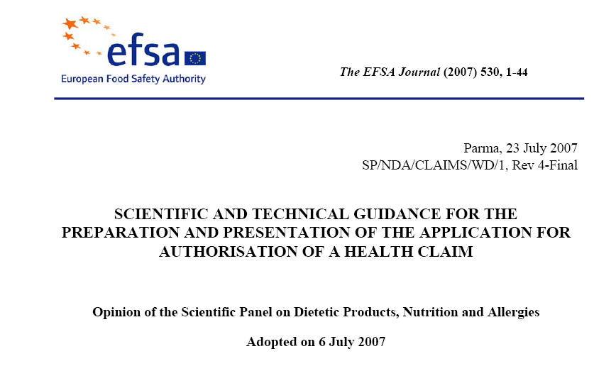
STRENGTHS

Slide 30
WEAKNESSES
Limited incorporation of staff technicians.
Certain research groups have few scientists (fragmentation).

Slide 31
OPPORTUNITIES
Close relations with Biopolis SL may also favour industrial cooperation.

Slide 32
THREATS
Absence of a defined scientific career and poor incentives fails to encourage the incorporation of new scientists.

Slide 33
RESEARCH STRATEGY (I)
GENERAL SCIENTIFIC OBJECTIVES
To promote and develop competitive research generating knowledge and technological developments to obtain better quality, safer and more nutritional foods, and the improvement of production and preservation processes.
These general objectives will be pursued via the implementation of the following specific objectives:
1. Promotion of the competitiveness of the IATA in food safety research.
2. Stimulation of the development and application of food processing and preservation technologies.
3. To promote research in food biochemistry, microbiology and biotechnology.
4. Improvement of the competitiveness in food quality, and stimulation of research on functional foods and nutrition.

Slide 34
RESEARCH STRATEGY (II)
Actions proposed for the development of each specific objective:
1. Promotion of the competitiveness of the IATA in food safety research.
Emerging pathogens in food alteration
Predictive microbiology and risk analysis
Metal contaminants
Meat residues
2. Stimulation of the development and application of food processing and preservation technologies.
Emerging technologies in food preservation
New packaging technologies and materials
High quality fruit juices
Processes for new meat-derived products
Processes for new cereal-derived products
Maintenance of postharvest fruit quality

Slide 35
RESEARCH STRATEGY (III)
3. To promote research in biochemistry, microbiology and biotechnology of foods.
Enzyme structure/function and antibody engineering
Proteins and peptides of industrial interest.
Metabolic engineering and molecular mechanisms of adaptation of micro-organisms to industrial processes.
Biochemistry and proteomics of meat products
Dough biopolymers
Biotechnology of non-conventional micro-organisms.
Biotechnology and functional genomics to improve fruit quality
4. Improvement of the competitiveness in food quality, and stimulation of research on functional foods and nutrition.
Analysis of food properties
Sensorial analysis and consumer perception
Mechanisms of action of probiotics and functional foods.
Development of new food products and evaluation of their quality and nutritional value.

Slide 36
ACTIONS TO ACHIEVE OBJECTIVES: ORGANIZATION
The current organization of the IATA has proved to be appropriate for the development of its activities.
Organization in three Departments is beneficial for the progress of research, although their modification or rearrangement to favour synergy is not excluded.
The IATA should encourage the formation of stable research groups of sufficient size to be competitive, without excluding independent projects or activities.
A more clear definition of the responsibilities of the Directive Board will be convenient, preferably focused on the Scientific Objectives of the Institute.
More resources for the institute’s manager should also be provided.

Slide 37
ACTIONS TO ACHIEVE OBJECTIVES: HUMAN RESOURCES (I)
Scientific Profile | Scientific Objective
 | F. S. | F P&P | B, B & M | FQ, FF & N
Biotech.of micro-organisms of relevance in the food industry
Biotech.of proteins of food technological relevance
Microbiological food safety
Molecular techniques in food quality and safety
Chemical contaminants in food ●
Physiological effects and development of functional foods●●
Evaluation of food allergenicity/toxicology ●●
Metabolic and nutritional studies of foods ●●
Quality and nutrition of cereal-derived products
Biochemistry of meat-derived products ●
Biotech. of quality and postharvest storage of plant products
Food quality and sensorial analysis ●
New technologies and processes in food preservation ●
New packages and technologies in food packaging
High throughput technologies in plant products ●●
Functional genomics and proteomics in foods ●●
● Replacements; ●● New research activities

Slide 38
ACTIONS TO ACHIEVE OBJECTIVES: HUMAN RESOURCES (II)
Category | Number | Justification
Research Assistant (Upper degree) | 3 | To cover deficiencies in general services at the IATA (genomics, proteomics, cell culture, technology transfer, etc)
Research Assistant (Lower degree) | 3 | To assist in the general services of the IATA
Laboratory Technicians | 8 | To provide technical support. Replacement of retired staff and incorporations into research groups lacking technicians.
Administrative Staff | 3 | Replacement of retired staff
General staff services | 3 | To fulfill general services across the IATA

Slide 39
ACTIONS TO ACHIEVE OBJECTIVES: GENERAL SERVICES
The IATA should consolidate and improve current general scientific services.
Specific actions:
Equipment and services in the Pilot Plant should be improved, since this is one of the strengths of the IATA and is of general use for most of the research groups.
Creation of a Cell Culture laboratory.
Laboratory for high-throughput technologies (proteomics, genomics and in the near future metabolomics).
Pilot Plant facilities for the Biotechnology Department are required.
Animal-house facilities.

Slide 40
ACTIONS TO ACHIEVE OBJECTIVES: EXTERNAL RELATIONS
Consolidation and improvement of the relations with the two main Universities of Valencia, UVEG and UPV. The IATA should become a point of reference for both Universities.
Maintenance of existing relations with current Associated Units and to explore future links with other research departments.
Improve relations with local government and with specific funding agencies.
Promote relationships with closely related research institutes (IBMCP, IVIA, AINIA, ITENE, IBV, etc).
Collaborations and agreements with industries and technological companies.
Potentiate agreements with other national and international Institutes and Universities, and long-term collaborations.

Slide 41
ACTIONS FOR THE DEVELOPMENT OF SCIENTIFIC
CULTURE AND DISSEMINATION
Science Weeks.
Open day activities.
Visits by secondary schools, technical colleges and University students
Popularization of the IATA in the media (press, TV, etc.).
Interactive website.
Increase IATA visibility to the Food Industries.
Immersion in the Universities: organizing and coordinating our own postgraduate courses and programs.

Slide 42
CONTACTS
DIRECTOR
Dr. Lorenzo Zacarías García
E-mail: lzacarias@iata.csic.es
VICEDIRECTOR
Dr. Antonio Martínez López
E-mail: amartinez@iata.csic.es
MANAGER
D. Ascensio Navarro Alarcó
E-mail: ascensio@iata.csic.es
ADDRESS:
Instituto de Agroquímica y Tecnología de Alimentos
Apartado Postal 73, 46100 Burjassot, Valencia
Tel: 34 963900022; Fax: 34 963636301
Website: http://www.iata.csic.es

