Slide 1


Improving what Nature provides:
Tuberculosis and the ansamycins case study
Ricardo Figueiredo
20/10/2010
Notes:
INICIO

Slide 2





Ricardo Figueiredo, ^{1,6} José Cardoso de Menezes, ¹ Pedro E. A. Silva, ² Rogelio Hernandez Pando, ³ Paula Castilho⁴ and Maria do Céu Costa^{4,5}
Improving what Nature provides:
Tuberculosis and the ansamycins case study

Slide 3
Improving what Nature provides:
Tuberculosis and the ansamycins case study
TÍTULO DO SEPARADOR
Presentation Outline
COMPUTATIONAL APPROACHES APPLIED TO DRUG DISCOVERY AND DEVELOPMENT (DDD)
TUBERCULOSIS
ANSAMYCINS/RIFAMYCINS
CASE STUDY: DEVELOPING NEW RIFABUTIN ANALOGS

Slide 4
Improving what Nature provides:
Tuberculosis and the ansamycins case study
TÍTULO DO SEPARADOR
Computational Approaches Applied to Drug Discovery and Development (DDD)

Slide 5
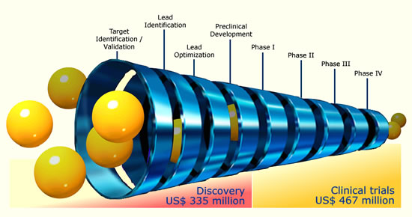
DRUG DISCOVERY
TÍTULO DO SEPARADOR
The Problem
Drug Discovery today are facing a serious challenge because of the increased cost and enormous amount of time taken to discover a new drug, and also because of rigorous competition amongst different pharmaceutical companies.

Slide 6
DRUG DISCOVERY
The New Paradigm
The last few years have seen a number of “revolutionary” new technologies:
  Gene chips, genomics and HGP
  Bioinformatics & Molecular biology
  More protein structures
  High-throughput screening & assays
  Virtual screening and library design
  Docking
  Combinatorial chemistry
  In-vitro ADME testing
  Other computational methods
How do we make it all work for us?

Slide 7
DRUG DISCOVERY
TÍTULO DO SEPARADOR
The Solution: Technology is impacting this process

Slide 8
COMPUTER-AIDED DRUG DESIGN
TÍTULO DO SEPARADOR
What does it involve?

Slide 9
COMPUTER-AIDED DRUG DESIGN (CADD)
Methodologies and strategies of CADD
Structure based drug design (SBDD) “DIRECT DESIGN”
  Followed when the spatial structure of the target is known;
  Molecular Docking (DOCK, Autodock, Flex X ...)
  Compounds with best complementarity to binding site are selected;
  De novo design (LUDI, CLIX, CAVEAT, LeapFrog...)
  Virtual modeling and optimization of structure
Ligand based drug design (LBDD) “INDIRECT DESIGN”
  Followed when the structure of the target is unknown;
  Random screening if no actives are known;
  Similarity searching;
  Pharmacophore mapping;
  QSAR (2D & 3D);
  Combinatorial library design.

Slide 10
STRUCTURE BASED DRUG DESIGN (SBDD)
TÍTULO DO SEPARADOR
The Process...

Slide 11
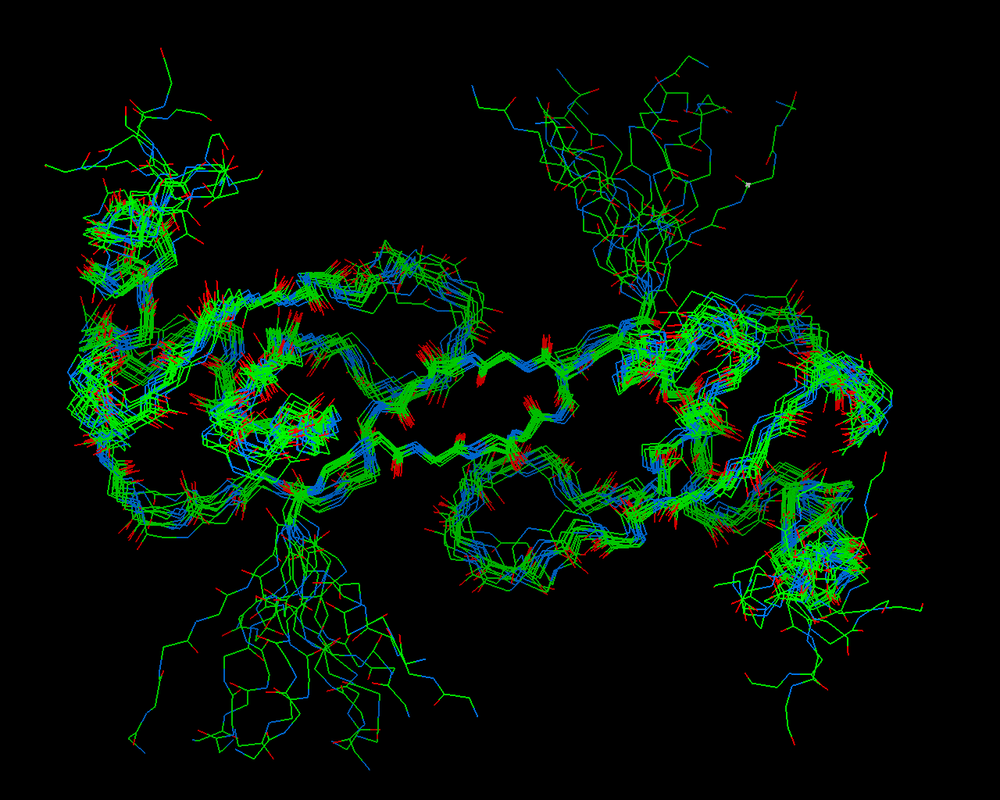
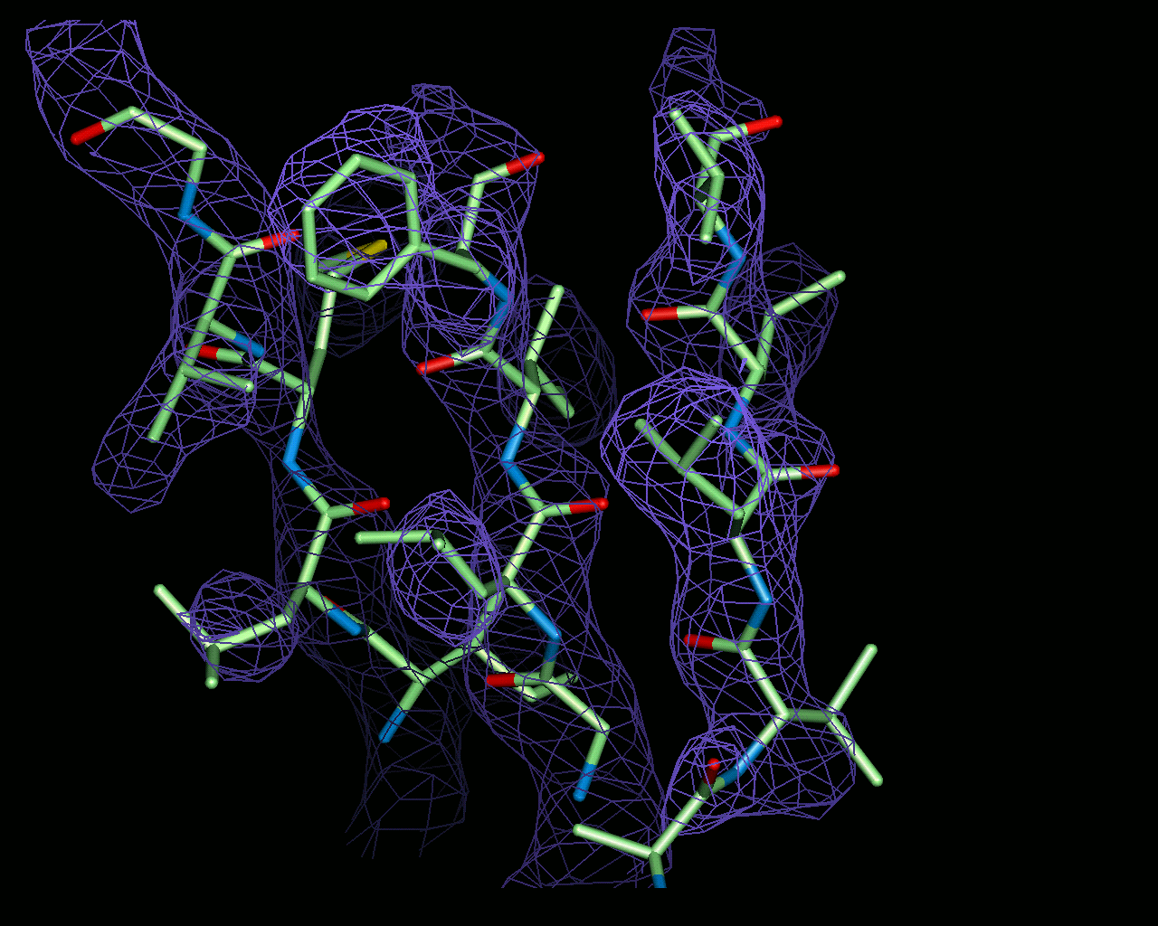

STRUCTURE BASED DRUG DESIGN (SBDD)
TÍTULO DO SEPARADOR
Getting the target structure...
3D structure of target receptors determined by
  X-ray crystallography
  NMR
  Homology modeling
Protein Data Bank
  Archive of experimentally determined 3D structures of biological macromolecules

Slide 12
STRUCTURE BASED DRUG DESIGN (SBDD)
Docking
Virtual screening approach to predict receptor-ligand binding modes
Scoring method used
  to detect correct bound conformation during docking process
  to estimate binding affinities of candidate molecule after completion of docking

Slide 13
STRUCTURE BASED DRUG DESIGN (SBDD)
Docking
Various approaches, including:
  Shape (DOCK program)
  incremental search methods (Flex X)
  Monte Carlo/Simulated annealing (AUTODOCK, FLO)
  Genetic algorithms (GOLD)
  Molecular dynamics
  Systematic search (Glide, Open Eye)
Two key issues
  sampling
  scoring/evaluating possible configurations/poses

Slide 14
Improving what Nature provides:
Tuberculosis and the ansamycins case study
TÍTULO DO SEPARADOR
Tuberculosis
A disease of poets and artists – an ancient plague considered once “fashionable”

Slide 15
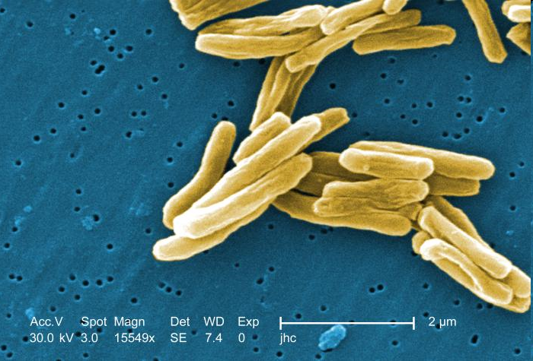
TUBERCULOSIS
Tuberculosis is a chronic or acute infection caused by bacteria that belong the genus Mycobacterium: M. tuberculosis, M. bovis, M. Africanum, M. microti e M. canettii.

Slide 16
TUBERCULOSIS
Key ideas about TB
TB is dificult to diagnose, dificult to treat, dificult to control.
TB therapeutic is long (6-9 months), and involves drug combinations (3 or 4 first line compounds like Rifampicin in the case of non-resistant tuberculosis strains). Healing rates very high in case of complaisance to the therapy.
PHILIP C. HOPEWELL, Tuberculosis, Fourth Edition:, 2010, Informa Healthcare

Slide 17
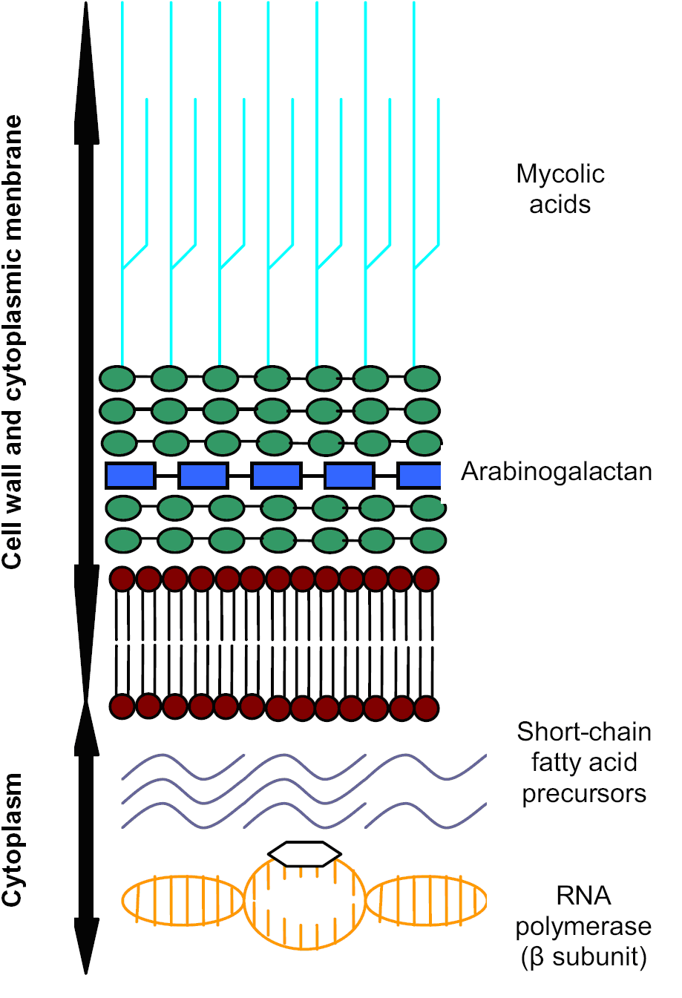
TUBERCULOSIS
TB: WHY IS IT SO DIFFICULT TO TREAT?
Morphological reasons
Specialized highly hydrophobic cell wall
Active efflux systems
Enzymes able to degrade/inactivate drugs

Slide 18
TUBERCULOSIS
TB: WHY IS IT SO DIFFICULT TO TREAT?
Heterogeneous metabolic activities of M. tuberculosis populations
M. tuberculosis has a tendency for dormancy (reduced metabolic activity)
Problem: Common antituberculosis drugs target cellular processes involved in cellular growth and division such as cell wall biogenesis and DNA replication
POOR ACTIVITY AGAINST SLOW- OR NON-GROWING BACTERIA

Slide 19
TUBERCULOSIS
TB: WHY IS IT SO DIFFICULT TO TREAT?
Heterogeneous locations of M. tuberculosis populations
Different locations correspond to different conditions and lead to the need for robust anti-TB drugs

Slide 20
TUBERCULOSIS
Stages of TB
There are 3 stages of tuberculosis:
Primary infection
Exposure to someone with active TB disease
Latent infection
Tuberculosis bacteria remain alive inside of the tubercle for years without causing disease. 5-10% “will” develop TB in lifetime.
Active disease
Bacteria actively replicate in lungs and other parts of the body.
Megan Murray, Tuberculosis, Fourth Edition: The Essentials, 2010, Informa Healthcare

Slide 21
TUBERCULOSIS
TÍTULO DO SEPARADOR
Contrary to all expectations... TB has evaded its own death
The Reality
2 billion people globally have latent tuberculosis infection
10 million new TB cases are reported worldwide annually
3 million persons die from TB every year
New Challenges to an Old Disease
HIV/ AIDS epidemic: TB is the most common opportunistic infection in AIDS patients
Impractical treatment: While DOTS (Directly Observed Therapy – Short Course) represents a major advance, current treatment with antibiotics is expensive and usually not completed
Multi-drug resistant TB: Mycobacterium tuberculosis resistant to current drugs
Lack of Effective Vaccine: BCG cannot prevent pulmonary TB in adults

Slide 22
TUBERCULOSIS
TÍTULO DO SEPARADOR
The Growing Plague
“Global Tuberculosis Control: Surveillance, Planning, Financing” (2008). WHO
“TB afflicts the poor above all”
Ninety-five percent of all TB sufferers live in developing countries

Slide 23
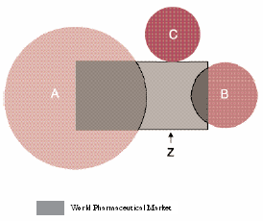
NEGLECTED DISEASES
Which are the needs attended by the Pharmaceutical market?
A represents global diseases
Ex: Cancer, cardiovascular diseases, mental illness, neurological disturbs…constitute the large concentration of efforts in R&D.
B represents the neglected diseases
Ex: Malaria and Tuberculosis. Reduced interest in R&D by pharmaceutical industry since those diseases affect mostly population of non-developed countries.
C represents extremely neglected diseases
Ex: African sleeping disease, Chagas disease (American trypanosomiasis), leishmaniasis…diseases that affect exclusively non-developed countries. Marginal to non-existing pharmaceutical industry R&D.
Z represents the fraction of market related to conditions not entirely medical like: beauty concerns, jet-leg…
Executive summary for new landscape of neglected disease drug development, The London School of Economics and Political Sciences, 2005.

Slide 24
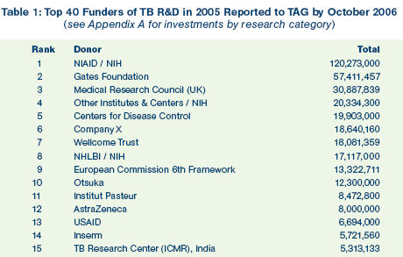
TUBERCULOSIS
TÍTULO DO SEPARADOR
Lack of interest from the Pharma companies...

Slide 25
TUBERCULOSIS
The Need for Therapeutics
Diagnostics:
Strain identification takes weeks/ months resulting in mortality and overprescription of drugs.
Drugs:
Incomplete regimen resulting in MDR/XDR-strains
Vaccines:
BCG relatively ineffective

Slide 26
TUBERCULOSIS
TÍTULO DO SEPARADOR
Drugs
Reality
No new class of TB drug developed in the last 30 years
  insufficient R&D
  high cost of development
  perceived low return on investment by big pharma/ biotech
The Promise
New TB medicines that shorten treatment from 6 months to 1-2 months
Novel drugs that target MDR-TB
“Sterilizing” drugs that attack M. tuberculosis in its latent phase
130 doses
10 doses

Slide 27
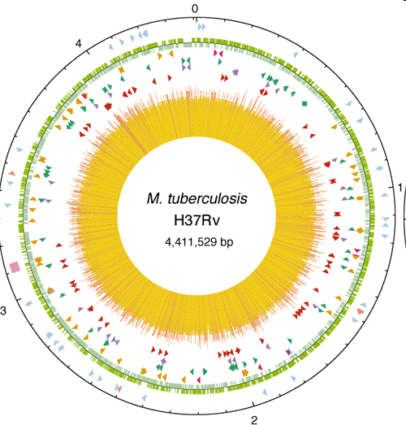
TUBERCULOSIS
TÍTULO DO SEPARADOR
Exploiting the TB genome
The complete genome of M. tuberculosis was sequenced in 1998.
Implication:
Sequence of every potential drug target and every potential antigen for vaccine available.
Post-genomic era: over 100 vaccine candidates have emerged that deserve screening in small animal models and this number is likely to increase.

Slide 28
TUBERCULOSIS
TÍTULO DO SEPARADOR
Exploiting the TB genome
http://www.webtb.org/
Mycobacterium Tuberculosis Structural Genomics Consortium
The TB Structural Genomics Consortium is a worldwide consortium of scientists developing a foundation for tuberculosis diagnosis and treatment by determining the 3-dimensional structures of proteins from M. Tuberculosis.
Key-Goals:
determine the structures of over 400 proteins from M. tuberculosis, and analyze these structures in the context of functional information;
basis for understanding M. tuberculosis pathogenesis and for structure-based drug design.
Consortium laboratories are collectively responsible for more than 3% of all protein structures in the PDB

Slide 29
TUBERCULOSIS
TÍTULO DO SEPARADOR
The Biotech Road-Map to TB Therapeutics
GENOMICS
TB on a chip:
- diagnosis
- functional genomics
Novel drug targets
Novel antigens for
vaccine development
PROTEOMICS
Drug target validation
Animal models of TB
Structural genomics
RATIONAL DRUG DESIGN
High-throughput screening of natural/ synthesized compounds
Bioinformatics
Molecular modeling

Slide 30
TUBERCULOSIS
TÍTULO DO SEPARADOR
Drug Discovery and Development Process
Target id. /validation (actively growing bacteria or persisting organisms?)
Identification and synthesis leads (HTS/in silico docking/testing fewer cmpds)
Synthesis/combinatorial chemistry (lead optimization)
Animal models for assessing drug efficacy
Drug resistance mechanisms
Latency and drug development
Emerging genome-scale tools for drug discovery
Chemistry/ pharmacy
Pre-clinical development*
Clinical trials*/surrogate markers (early evidence of drug efficacy/CT shortening)
Regulatory considerations
Technology transfer
Gaps and priorities for action
RT-PCR in sputum samples to look for bacterial mRNA
→ marker for response to therapy
Luciferase assays and molecular beacons
* Multidrug therapy issues must be addressed

Slide 31
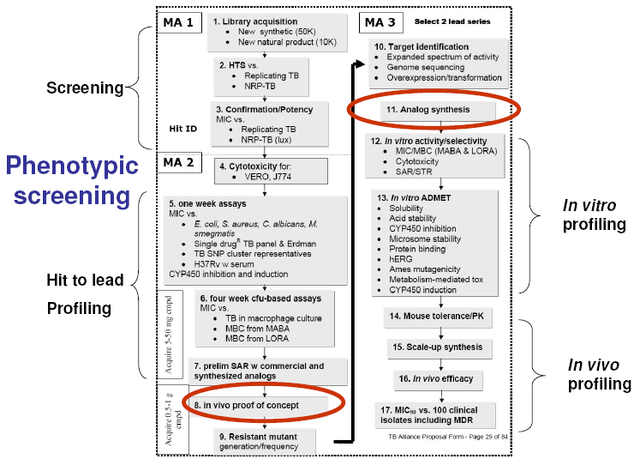
TUBERCULOSIS
TÍTULO DO SEPARADOR
Drug Discovery and Development Process
Experimental Design and methods

Slide 32
TUBERCULOSIS
TÍTULO DO SEPARADOR
TB drugs and targets
DNA Gyrase
Ciprofloxacin
Ofloxacin
Levofloxacin
RNA Polymerase
Rifampin
Rifabutin
Rifapentine
Folic Acid Metabolism
p-Aminosalicylic acid
DHFA
DNA
PABA
Cell Wall Synthesis
Ethambutol
Cycloserine
Isoniazid (pro-drug)
Ethionamide (pro-drug)
Prothionamide (pro-drug)
Ribosome
Streptomycin
Kanamycin
Amikacin
Capreomycin
Viomycin
mRNA
Pyrazinoic Acid
(POA)
PZase
Peptide
Proton Motive Force*
Pyrazinamide (pro-drug)

Slide 33
TUBERCULOSIS
TÍTULO DO SEPARADOR
TB current pipeline
Global Alliance for Development, 2010

Slide 34
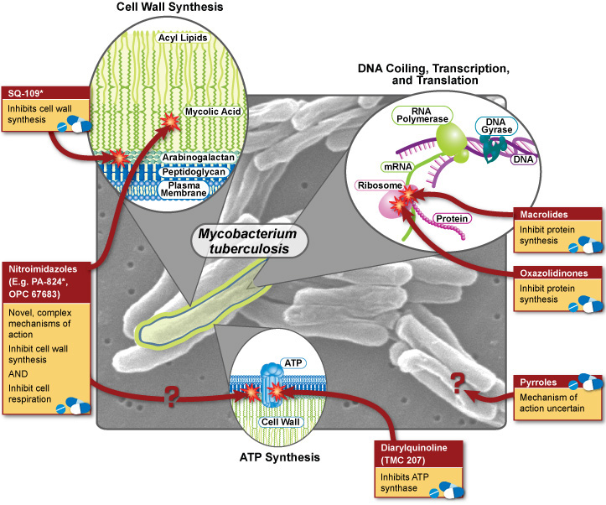
TUBERCULOSIS
TÍTULO DO SEPARADOR
New TB drugs in development and its drug targets

Slide 35
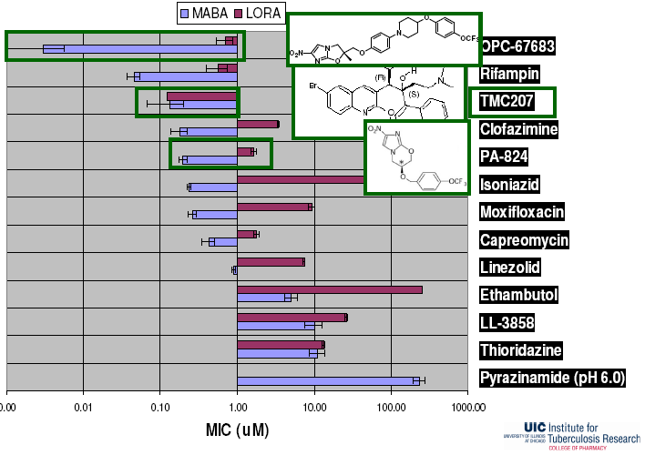
TUBERCULOSIS
TÍTULO DO SEPARADOR
Activity vs replicating and non-replicating TB
Microplate Alamar Blue Assay (MABA)
Low Oxygen Recovery Assay (LORA)

Slide 36
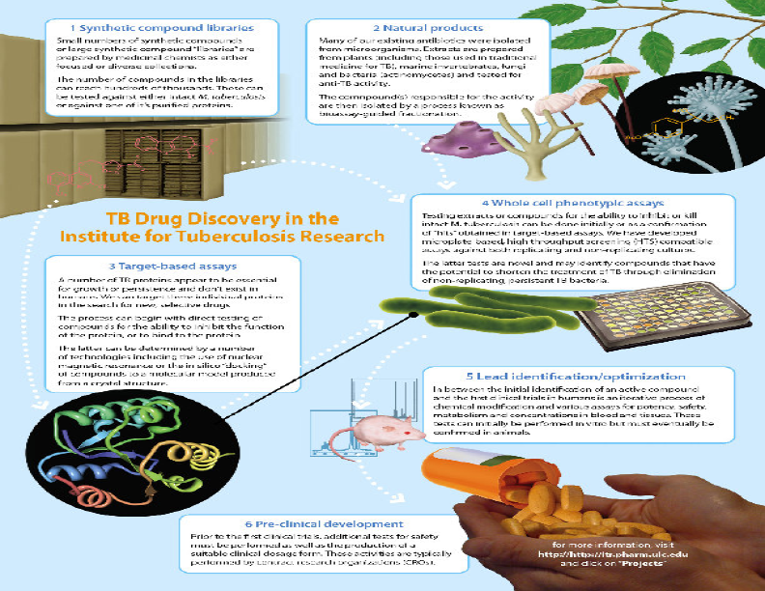
TUBERCULOSIS
TÍTULO DO SEPARADOR
Methodologies and Strategies for New TB drugs
• Ligand-based whole cell screening
– optimize TB drugs
– optimize non-TB antimicrobial classes
– novel synthetic
– novel natural products
  ethnomedical
• Target-based discovery
– Target identification
– Screening (in silico, NMR, functional)

Slide 37
TUBERCULOSIS
TÍTULO DO SEPARADOR
Target-based antibacterial drug discovery (vs phenotypic approach)
Pro
• Predict phenotype
• Selective
• Sensitivity
• Rational approach to:
– Improve potency
– Reduce toxicity?
– Improve DMPK?
Con
• No track record
• “Drugability” uncertain
• Single target may be undesirable – high rate of resistance?
• Does not consider penetration into bacteria/efflux and/or metabolism

Slide 38
TUBERCULOSIS
TÍTULO DO SEPARADOR
Natural vs Synthetic products
Pro:
great diversity
• Natural selection for biological activity
Cons:
• don’t know percentage of active compound in extract; therefore don’t know potency of active compound until it is isolated – complicates prioritization
• Pre-existing mechanisms of resistance in nature

Slide 39
TUBERCULOSIS
TÍTULO DO SEPARADOR
New approaches in natural products screening (in general)
Traditional
• Diffusion or low other low throughput assays
• Screen crude extracts
• Test only natural products
Contemporary
• Microbroth metabolic assays
• Pre-fractionate before primary screen
• Make semisynthetic derivatives from selected natural scaffolds

Slide 40
TUBERCULOSIS
TÍTULO DO SEPARADOR
Example of Natural-based products: Macrolides

Slide 41
TUBERCULOSIS
TÍTULO DO SEPARADOR
New Approaches to TB
Dual action compounds
• Oxazolidinone-quinolones
• Rifampin-quinolones
• Rifampin-nitroaromatics
Bacteriophage or phage lytic enzymes
Skin and mucous membranes
Lung delivery to deliver high concentration without first pass metabolism

Slide 42
Improving what Nature provides:
Tuberculosis and the ansamycins case study
TÍTULO DO SEPARADOR
Ansamycins / Rifamycins

Slide 43
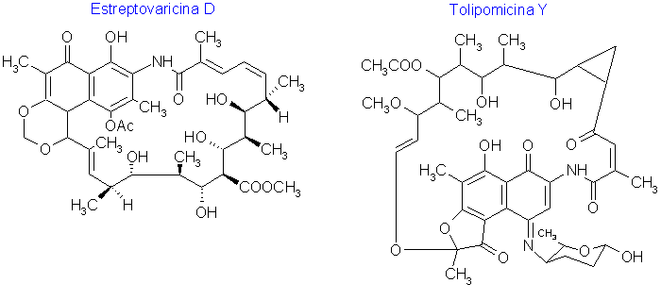
ANSAMYCINS
Macrocyclic antibiotics, natural or natural-derived compounds, with an aliphatic ansa bridge, that is, a bridge that connects two non-adjacent positions of the aromatic nucleous. Ansamicins have a 17 member chain and the aromatic nucleous is a naphtalene.

Slide 44
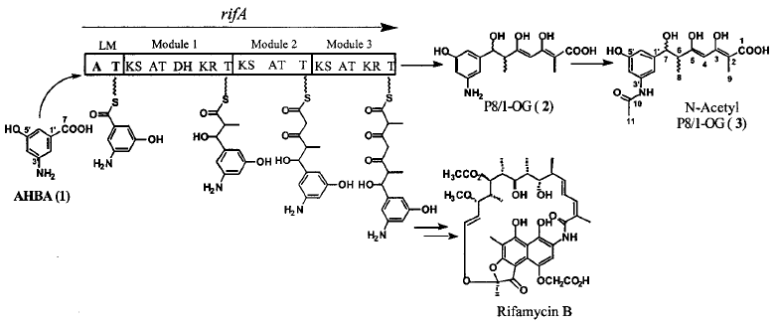
RIFAMYCINS
Natural derived products with broad anti-infective activity
Amycolatopsis mediterranei Fermentation
Broad-range antibiotics Class
  Gram-Positive and Gram-negative bacteria
  Mycobacteria: M. tuberculosis and MAC

Slide 45
RIFAMYCINS
Rifamycins classes:
  Substitutions only at position 3
  Pyridoimidazorifamycins
  Benzoxazinorifamycins
  Spiropiperidylrifamycins (Rifabutin)
PRIFTIN®/RIFAPENTINE
(FDA, 1998)
RIFATER®/RIFAMPICIN

Slide 46
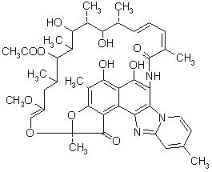
RIFAMYCINS
Rifamycins classes:
  Substituições apenas na posição 3
  Pyridoimidazorifamycins
  Benzoxazinorifamycins
  Spiropiperidylrifamycins (Rifabutin)
Xifaxan™ (Salix Pharmaceuticals)
RIFAXIMIN

Slide 47
RIFAMYCINS
Rifamycins classes:
  Substitutions only at position 3
  Pyridoimidazorifamycins
  Benzoxazinorifamycins
  Spiropiperidylrifamycins (Rifabutin)
RIFALAZIL

Slide 48
RIFAMYCINS
Rifamycins classes:
  Substitutions only at position 3
  Pyridoimidazorifamycins
  Benzoxazinorifamycins
  Spiropiperidylrifamycins (Rifabutin)

Slide 49
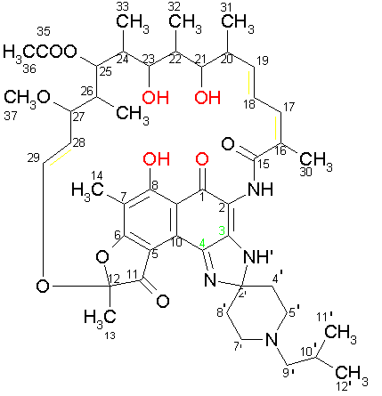
RIFAMYCINS
Rifamycins SAR
RNAP inhibition depends of the oxygen atoms: 1-O, 8-OH, 21-OH and 23-OH. ^{[a]}
Hydrogenation/epoxidation of the ansa chain double bonds lead to less antimicrobial activity. ^{[b]}
Subtitutions at positions 3 and 4 change the cell penetration capacity without changes in its activity towards the RNAP. ^{[b]}
^{[a]} – Lancini G. et al.; (1977); ^{[b]} – Brufani M. ; (1977)

Slide 50
RIFAMYCINS
MOA - Inhibits bacterial DNA-dependant RNA-polymerase
Steric block model for the rifamycins
Rifamycins sterically block the growing RNA chain (yellow) in the transcription initiation complex of RNAP (gray), sigma factor (magenta), and DNA template (red) and non-template (blue) strands. At some distance from the rifamycin-binding pocket is seen the Mg²⁺ ion (magenta ball) at the catalytic site.
Aristoff PA, et al., Rifamycins e Obstacles and opportunities, Tuberculosis (2010)

Slide 51
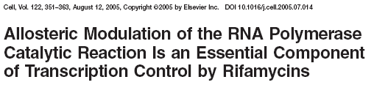
RIFAMYCINS
MOA - Inhibits bacterial DNA-dependant RNA-polymerase
Artsimovitch et al., 2006, Cell, 122: 351-364
Feklistov et al., 2008, PNAS, 105(39): 14820-14825

Slide 52

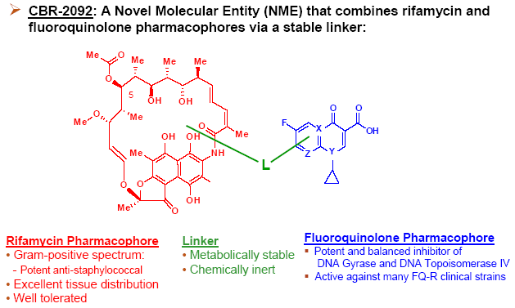
RIFAMYCINS
TÍTULO DO SEPARADOR
Recent developments
2006
Potential in bacterial biofilms in medical and prosthetic devices

Slide 53
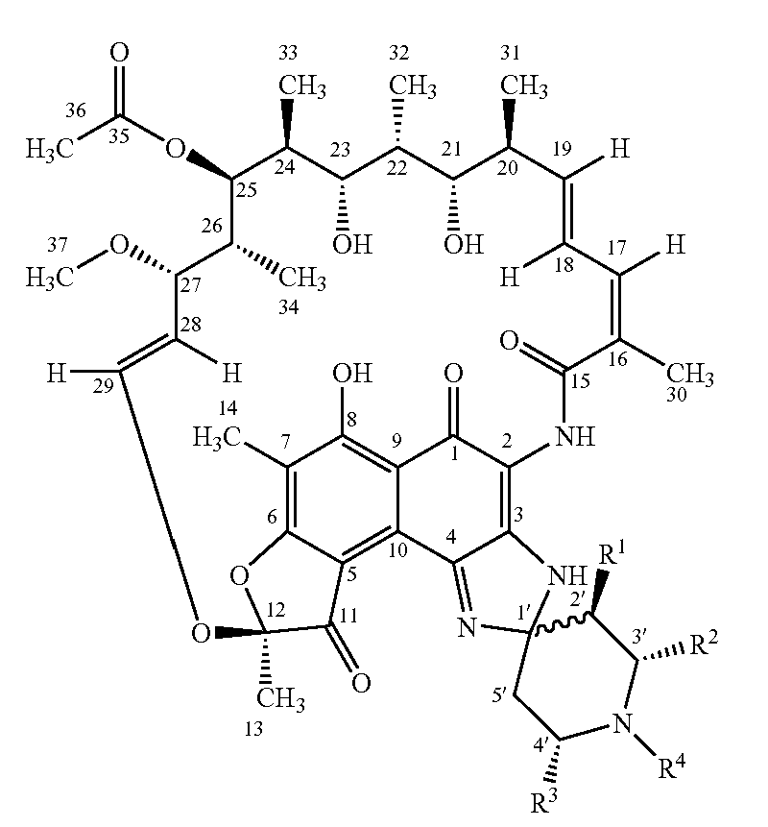
RIFAMYCINS
TÍTULO DO SEPARADOR
Recent developments
Functionalization of the piperidinic ring
J. Barluenga et al., Bioorganic & Medicinal Chemistry Letters, 2006

Slide 54
Improving what Nature provides:
Tuberculosis and the ansamycins case study
TÍTULO DO SEPARADOR
CASE STUDY: Developing New Rifabutin Analogs

Slide 55
CASE STUDY: Developing New Rifabutin Analogs
TÍTULO DO SEPARADOR
Development Strategy – Lead Optimization
Lead: Rifabutin

Slide 56
CASE STUDY: Developing New Rifabutin Analogs
TÍTULO DO SEPARADOR
Is this approach the solution to TB?
Solution ?
Working near the latest Knowledge and methods. Lower probability of cross-resistance.
Reality of the project
Solution ?
Less expenditure / Less resources allocated

Slide 57
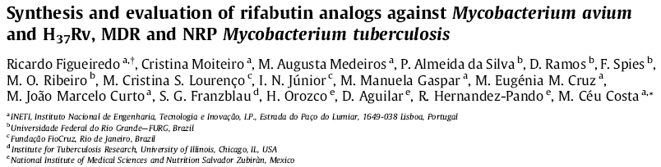
CASE STUDY: Developing New Rifabutin Analogs
1st Series of Rifabutin Analogs
Bioorg. Med. Chem., 2009

Slide 58
CASE STUDY: Developing New Rifabutin Analogs
TÍTULO DO SEPARADOR
1st Series of Rifabutin Analogs
In vitro testing
MDR-MTB strains
MICs of N’-acetyl-rifabutinol 6 and N’-undec-11-enoyl-rifabutin 8 < RFB 1
NRP-MTB (LORA assay)
MIC of N’-undec-11-enoyl-rifabutin 8 = RFB 1

Slide 59
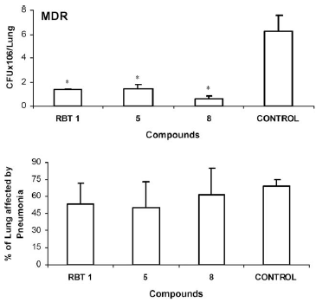
CASE STUDY: Developing New Rifabutin Analogs
TÍTULO DO SEPARADOR
1st Series of Rifabutin Analogs
In vivo testing
H₃₇Rv
N’-acetyl-rifabutin 5 was most active against MTB H37Rv strain, promoting a statistically significant reduction of lung bacilli load.
MDR-MTB
N’-undec-11-enoyl-rifabutin 8 was more efficient against MDR strains, inducing lower bacilli loads than RBT 1 and RBT 5

Slide 60
CASE STUDY: Developing New Rifabutin Analogs
TÍTULO DO SEPARADOR
1st Series of Rifabutin Analogs
AAC, in press, 2010

Slide 61
CASE STUDY: Developing New Rifabutin Analogs
TÍTULO DO SEPARADOR
1st Series of Rifabutin Analogs
In vitro testing
rpoB gene mutations
RFP resistant strains
Best overall results
Mutations in Ser531Leu and His526Arg lead to highly resistant strains to all tested compounds
Absence of cross-resistance between RFP and RFB

Slide 62
CASE STUDY: Developing New Rifabutin Analogs
Discovering interpretable conformational differences
– first step towards a SAR’s analysis
Background: Why studying Rifamycin confomations?
Our Knowledge from NMR studies:
Methyl C₃₄ oscillates back and forth over the chromophore by means of the rocking of the central part of the ansa chain.
Previous works from Arora et al. (J. Antibiot., 1992) and more recently of Bachi et al (New J. Chem., 2008), describe two limiting conformers: open (active) and close (inactive).
RFB 7
Figure: High-field region of 1H-NMR at different temperatures (CH₃-34 peak variation)

Slide 63
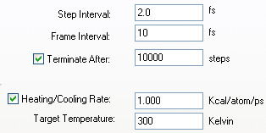

CASE STUDY: Developing New Rifabutin Analogs
Discovering interpretable conformational differences
– first step towards a SAR’s analysis
1) The poor man solution: Performing molcular structure Total Energy minimization studies – a low burden computational resources strategy
Energy Minimization data
ChemBioOffice 2008
Acceptance criteria: Minimum RMS gradient = 0.01 or same number of iterations from 3 consecutive runs.
Figure: Overlay of all Total Energy minimized RFB analogs

Slide 64
CASE STUDY: Developing New Rifabutin Analogs
Discovering interpretable conformational differences
– first step towards a SAR’s analysis
1) The poor man solution: Performing molcular structure Total Energy minimization studies – a low burden computational resources strategy
Major differences in conformations:
- Furanone vs furanol analogs
Figure: Difference arising from the reduction of C11-furanone: In the image on the left is seen the relative position of the furanol hydroxyl of RFB3 and RFB 5 when comparing to the furanone ketone; In the right image we notice that it is possible to group with basis on the C28=C29 double bond the furanone and the furanol RFB derivatives.

Slide 65
CASE STUDY: Developing New Rifabutin Analogs
Discovering interpretable conformational differences
– first step towards a SAR’s analysis
1) The poor man solution: Performing molcular structure Total Energy minimization studies – a low burden computational resources strategy
Major differences in conformations:
- Furanone vs furanone analogs
Figure: Difference arising from the reduction of C11-furanone: In the image on the left are seen the distances between C11-oxygenated function and the C25- acetyl carbonyl or C25-OH (deacetyl derivatives); in the right image are displayed the measured distances between the same C11-oxygenated group and C23-OH

Slide 66
CASE STUDY: Developing New Rifabutin Analogs
Discovering interpretable conformational differences
– first step towards a SAR’s analysis
1) The poor man solution: Performing molcular structure Total Energy minimization studies – a low burden computational resources strategy
Major differences in conformations:
- N’-acylated vs non acylated analogs
Figure: Zoom of the isobutylpiperidyl moiety of RFB 1-7 viewed from below the cromophore system. The oval form A groups RFB 1 and the other non N’-acylated derivatives (RFB 2 and RFB 3), while oval form B groups the N’-acylated RFB 1 derivatives (RFB 4, RFB 5, RFB 6 and RFB 7).

Slide 67
CASE STUDY: Developing New Rifabutin Analogs
PDB crystal structure of RFB/ RNAP T. Thermophillus
Several van de Waals interactions with residues of the RNAP
Hydrogen bonding occurs in numerous places
Strong affinity of the rifabutin for the RNAP
Adapted Ligplot diagram (E. coli numbering) representing the interactions of RFB 1 with 4Å distance interacting residues of chain RNAP (Chain C) in a crystal (2A68 PDB file).

Slide 68
CASE STUDY: Developing New Rifabutin Analogs
Discovering interpretable conformational differences
– first step towards a SAR’s analysis
ChemBioOffice 2008
1) The poor man solution...
Overlaying over RFB structure in the crystal (PDB file: 2A68) performing a total energy minimization of the RIF/RNAP complex of all residues located within 10 Å of RFB)
Figure: Stereo view of the Rif binding pocket of T. therm. core RNAP interacting with: RFP (A), RFB 1 (B), RFB 2 (C), RFB 3 (D), RFB 4 (E), RFB 5 (F), RFB 6 (G) and RFB 7 (H). The residues represented with sticks have atoms located within 4.0 Å of the Rifs. The Rifs are represented with the ball&stick model. In each case, oxygen atoms are represented in red, nitrogen atoms in blue, sulphur in yellow and hydrogen atoms in white.

Slide 69
CASE STUDY: Developing New Rifabutin Analogs
Discovering interpretable conformational differences
– first step towards a SAR’s analysis
2) Sampling the conformational space / Preparing the Ligands for Docking
Steps:
1st – Design the Ligands
From RFB structure on the RFB/RNAP T. Therm. in 2A68 PDB file
Closest to the less energy conformation?

Slide 70
CASE STUDY: Developing New Rifabutin Analogs
Discovering interpretable conformational differences
– first step towards a SAR’s analysis
2) Sampling the conformational space / Preparing the Ligands for Docking
Steps:
2st – Testing conditions
≠ Molecular Mechanics methods: MM+, Amber, OPLS;
Semi-empiric methods: AM1, PM3
Variation of the MM Algorithm:
  Steepest Descent / Fletcher-Reeves (conjugate gradient) / Polak-Ribiere / Newton-Raphson (block diagonal) / Conjugate directions
3rd – Define which torsions to move

Slide 71
CASE STUDY: Developing New Rifabutin Analogs
Discovering interpretable conformational differences
– first step towards a SAR’s analysis
2) Sampling the conformational space / Preparing the Ligands for Docking
Conformational Studies
Software: Hyperchem 8.05
Method: PM3
Algorithm: Steepest Descendent
Conformations generated for each compound: 35000 (2-3 days of computational work for each)
Keep the 20 of lowest energy
Figure: Overlay of the lower energy conformations of all RFB analogs

Slide 72
CASE STUDY: Developing New Rifabutin Analogs
Discovering interpretable conformational differences
– first step towards a SAR’s analysis
2) Sampling the conformational space / Preparing the Ligands for Docking
Effect of the interaction with the residues at the active site:
- Opening conformation (oxygen atoms from the ansa chain further apart from the ones at the naphtalenic chromophore)
Figure: In Dark Pink (RFB1 without the RNAP interaction effect); In light grey: RFB crystal structure from the 2A68 RNAP-RFB crystal structure (target interactions considered)

Slide 73
CASE STUDY: Developing New Rifabutin Analogs
TÍTULO DO SEPARADOR
More recently synthesized/ synthesis attempted RFB analogs
Biological activity studies recently conducted / Conformational and docking studies in their way

Slide 74
CASE STUDY: Developing New Rifabutin Analogs
TÍTULO DO SEPARADOR
More recently synthesized RFB analogs
Biological activity studies recently conducted / Conformational and docking studies in their way

Slide 75
Acknowledgments
INETI
Augusta Medeiros
Ana Isabel Rodrigues
Cristina Moiteiro
Lina Santos
LMCB – UC
Luis Duarte
Prof. Rui Fausto
Conformational Studies
Institute for Tuberculosis Research
Prof. Franzblau group
Dormancy assays
Fundação para a Ciência e Tecnologia for PhD grant (SFRH/BDE/15554/2005).

